Slide 1
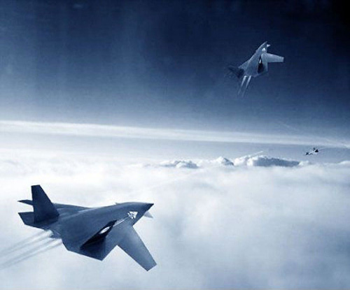
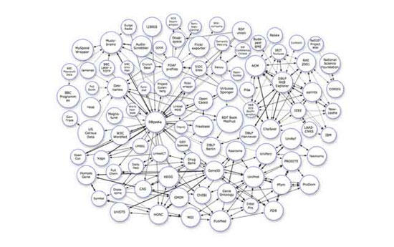
Welcome
to
Analysis and Design of Algorithms

Slide 2
Divide & Conquer Algorithms

Slide 3
諫逐客書—李斯
文選自 <史記.李斯列傳>，是李斯上呈秦王政的一篇奏疏:李斯谏逐客书。
惠王用张仪之计，拔三川之地，西并巴、蜀，北收上郡，南取汉中，包九夷，制鄢、郢，东据成皋之险，割膏腴之壤，遂散六国之纵，使之西面事秦，功施到今。昭王得范雎，废穰侯，逐华阳，强公室，杜私门，蚕食诸侯，使秦成帝业。
注：六国：燕、赵、韩、魏、齐、楚

Slide 4
4. Divide & Conquer Algorithms
The General Method
Time Complexity
Common Recurrence relations
A General Divide & Conquer Recurrence
Closest Pair Problem
Count Inversions
Merge Sort Algorithm
Quicksort Algorithm
An Application of Quicksort: Convex Hull
Selection by Partitioning
……

Slide 5
4.1 The General Method
To solve a problem using Divide and Conquer:
• Divide it into smaller problems
• Solve the smaller problems recursively
• Combine their solutions into a solution
for the big problem

Slide 6
4.1 The General Method
The base case for recursion is a sub-problem of constant (and small) size.
Analysis of D&Q algorithms is done by constructing a recurrence relation
We can obtain T(n) in a closed form by solving the recurrence relation

Slide 7
4.1.1 The General Method
For problem p, small(p) = true if p is simple. In this case S(p) is the solution. Otherwise, Divide, Conquer, then Combine.
Divide & Conquer Algorithm
DQ(p)
{ if small(p) return S(p);
else {
1. Divide p into smaller instances p₁,p₂,..,p_{k}
2. Apply DQ to each p_{i}
3. Return Combine(DQ(p₁),DQ(p₂),…,DQ(p_{k}))}
}

Slide 8
4.1.2 Time Complexity
Let g(n) = time for S(p) when p is small
f(n) = time to divide p and combine solutions
then
for p small T(n) = g(n)
otherwise

Slide 9
4.1.3 Common Recurrence Relations
A recursive algorithm that halves the input in one step then processes the two halves:
T(n) = 2T(n/2) + 1 for n >1 with T(1) given
A recursive algorithm that halves the input in one step then processes one half and ignores the other:
T(n) = T(n/2) + 1 for n >1 with T(1) given

Slide 10
Common Recurrence Relations
A recursive algorithm that examines every element before dividing and then ignores one half:
T(n) = T(n/2) + n for n >1 with T(1) given
A recursive algorithm that makes a linear pass through the input, before, during or after it is split into two halves then processes the two halves:
T(n) = 2 T(n/2) + n for n >1 with T(1) given

Slide 11
Time complexity of the general algorithm
Time complexity:
where S(n) : time for splitting
M(n) : time for merging
b : a constant
c : a constant
e.g. Binary search ?
e.g. quick sort
e.g. merge sort e.g. 2 6 5 3 7 4 8 1

Slide 12
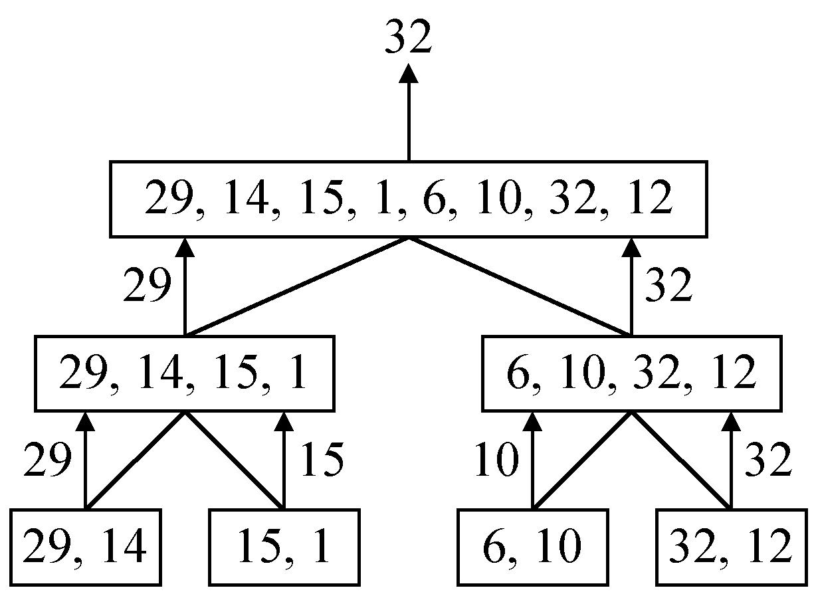
4.2 A simple example
finding the maximum of a set S of n numbers

Slide 13
Time complexity
Time complexity:
Calculation of T(n):
Assume n = 2^{k},
T(n) = 2T(n/2)+1
= 2(2T(n/4)+1)+1
= 4T(n/4)+2+1
:
=2^{k-1}T(2)+2^{k-2}+…+4+2+1
=2^{k-1}+2^{k-2}+…+4+2+1
=2^{k}-1 = n-1

Slide 14
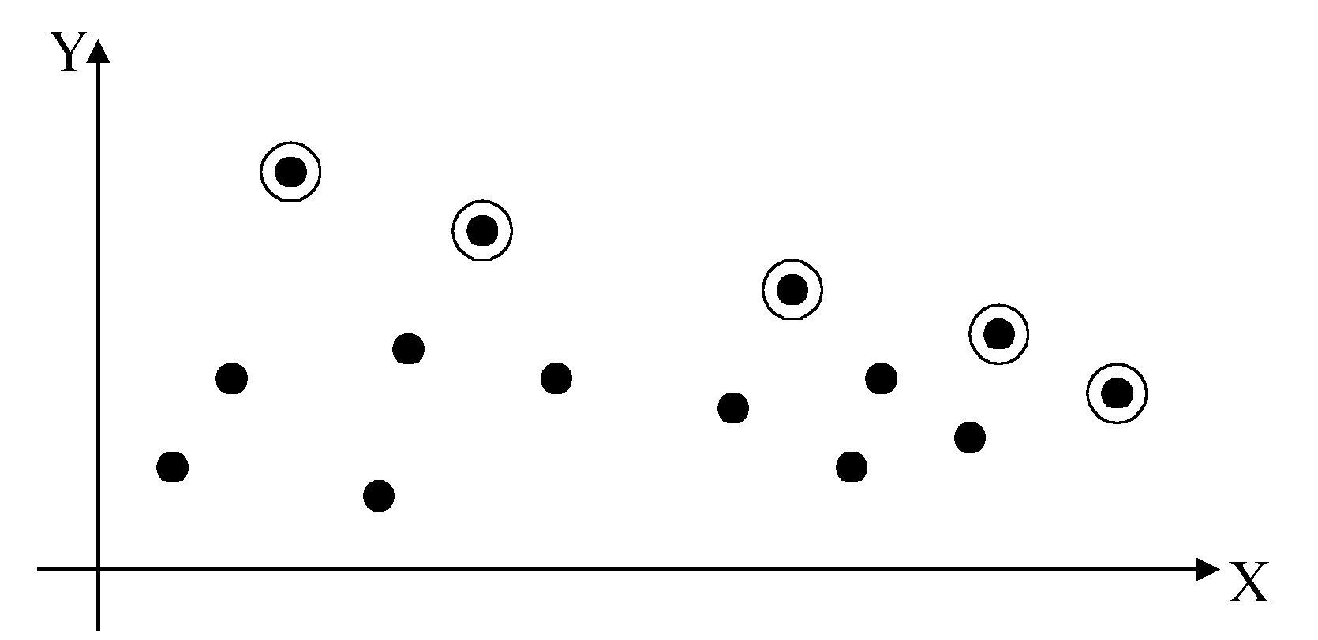
4.3 2-D maxima finding problem
Def : A point (x₁, y₁) dominates (x₂, y₂) if x₁ > x₂ and y₁ > y₂. A point is called a maximum if no other point dominates it
Straightforward method : Compare every pair of points.
Time complexity:
O(n²)

Slide 15
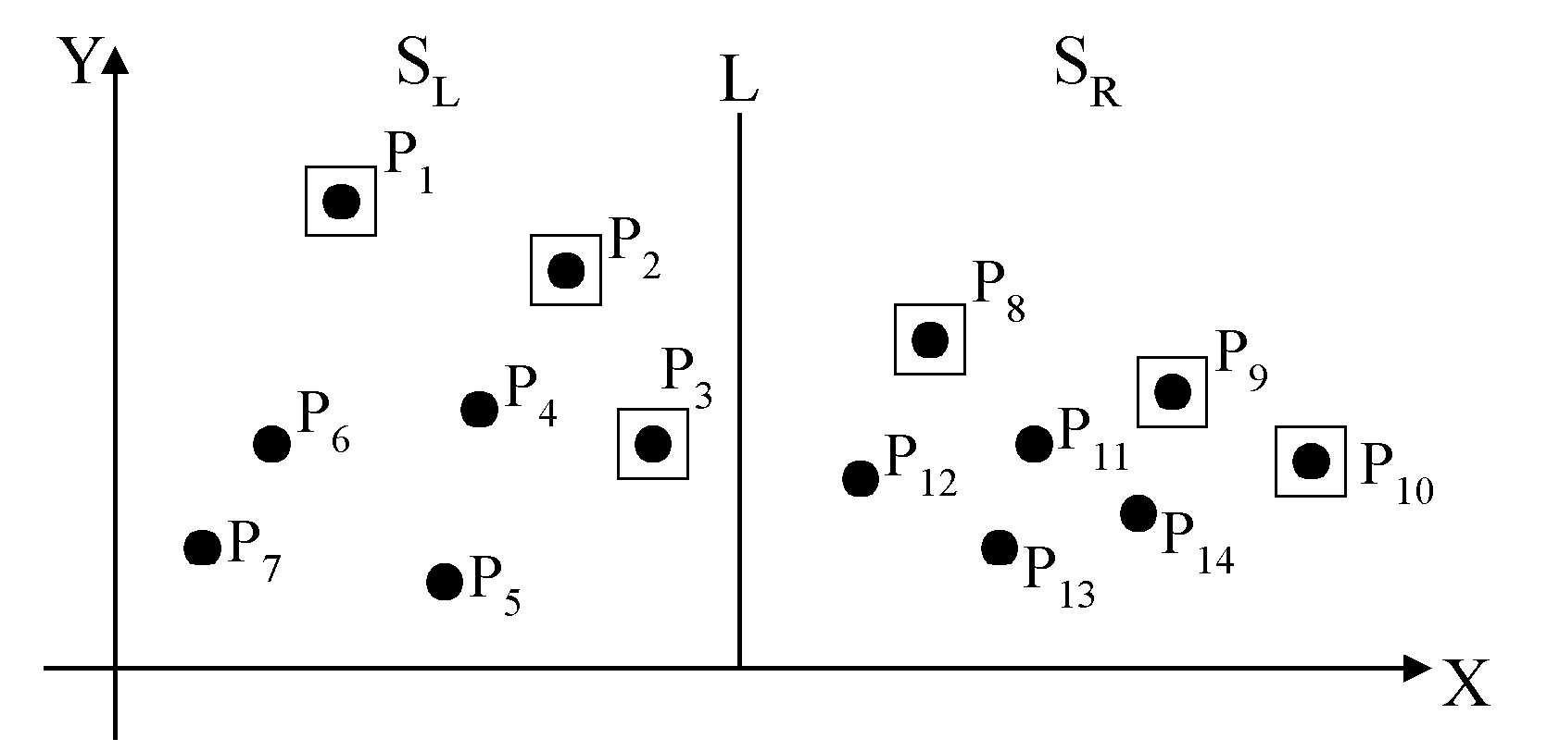
Divide-and-conquer for maxima finding
The maximal points of S_{L} and S_{R}

Slide 16
The algorithm:
Input: A set S of n planar points.
Output: The maximal points of S.
Step 1: If S contains only one point, return it as the maximum. Otherwise, find a line L perpendicular to the X-axis which separates S into S_{L}and S_{R}, with equal sizes.
Step 2: Recursively find the maximal points of S_{L} and S_{R} .
Step 3: Find the largest y-value of S_{R}, denoted as y_{R}. Discard each of the maximal points of S_{L} if its y-value is less than y_{R}.

Slide 17
Time complexity: T(n)
Step 1: O(n)
Step 2: 2T(n/2)
Step 3: O(n)
Assume n = 2^{k}
T(n) = O(n log n)

Slide 18
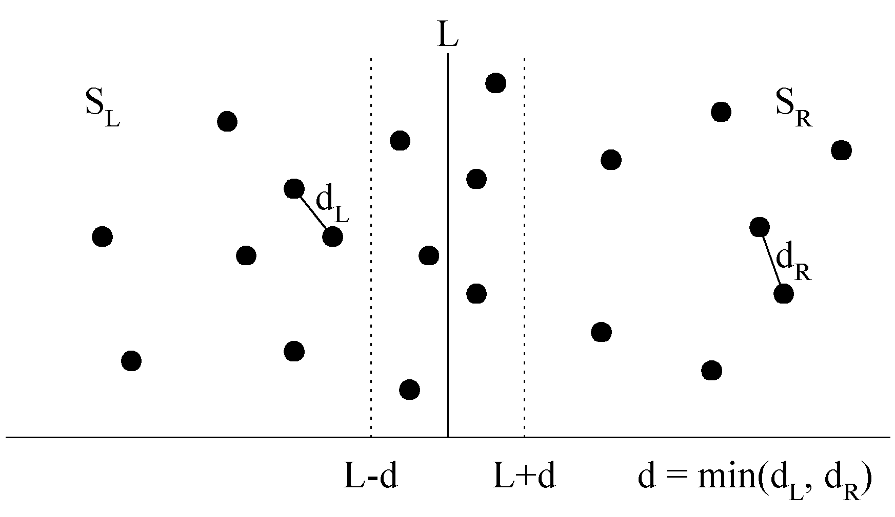
4.4 The closest pair problem
Given a set S of n points, find a pair of points which are closest together.
1-D version :
Solved by sorting
Time complexity :
O(n log n)
 2-D version

Slide 19
Closest Pair Problem
The Closest Pair Problem in 1-D
Given a set S = {p₁, p₂, ..., p_{N}} of N points on a line,
find the two points of S whose distance is smallest.
Simple solution
D_{min}= ∞
for each p_{i} in S
for each p_{j} in S and (i != j)
if (D_{ij} < D_{min}) { D_{min}= D_{ij} ; K = i; L = j;}
return K , L, D_{min}
Time Complexity = O(N²)
Can we do better?

Slide 20
Closest Pair Problem
Solution with Sorting
Sort the points according to their distance from the origin.
After the points are sorted, the closest pair will lie next to each other somewhere in sorted order. Thus a linear-time scan through them completes the job.
Sorting will cost O(N log N) and the scan will cost O(N) so that the total cost is O(N log N) + O(N) = O(N log N).
Obviously, the use of sorting is much more efficient than the first method.
Any other ideas?

Slide 21
Closest Pair Problem
D&Q Algorithm in 1-D
Partition S, a set of points on a line, into two sets S1 and S2 at some point m such that for every point p ∈ S1 and q ∈ S2, p < q. Point m could be the median
Solve Closest Pair recursively on S1 and S2
Let {p1, p2} be the closest pair in S1 with δ1 = |p2 - p1| and {q1, q2} the closest pair in S2 with δ2 =|q2 - q1|

Slide 22
Closest Pair Problem
Let δ be the smallest distance found so far:
δ= min (δ₁, δ₂)
The closest pair in S is either {p1, p2} or {q1, q2} or some {p3, q3} with p3 ∈ S1 and q3 ∈ S2. Which p3,q3?

Slide 23
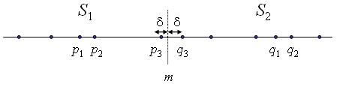
Closest Pair Problem
Let δ be the smallest separation found so
far:
δ = min(|p2 - p1|; |q2 - q1|)

Slide 24
Closest Pair Problem
How many points of S1 or S2 can lie within δ of m?
Since δ is the distance between the closest pair in either S1 or S2, there can only be at most 1 point in each side.
Therefore, the number of distance computations required to check for a closest pair {p3, q3} with p3 ∈ S1 and q3 ∈ S2 is O(1).

Slide 25
Closest Pair Problem:D&Q Algorithm for 1-D
Closest-Pair (S)
If |S| = 1, δ = ∞ else If |S| = 2, δ = |p2 - p1|;
else do the following steps:
1. Let m = median(S).
2. Divide S into S1; S2 at m.
3. δ₁ = Closest-Pair(S1).
4. δ₂ = Closest-Pair(S2).
5. δ₁₂ is minimum distance across the cut
= |p3 – q3|
6. Return δ = min(δ₁ , δ₂ ,,δ₁₂).

Slide 26
Closest Pair Problem: D&Q Algorithm for 1-D
Analysis:
Finding the median point (selection problem) is O(N)
Partitioning around the median is O(N)
Computing δ in each recursive call is O(1)
Hence, T(N) = 2T(N/2)+O(N) so that
T(N) = O(N log N)

Slide 27
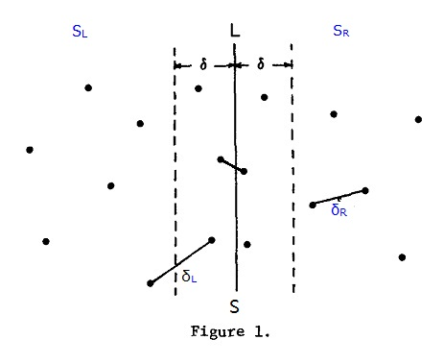
Closest Pair Problem:D&Q Algorithm for 2-D

Slide 28
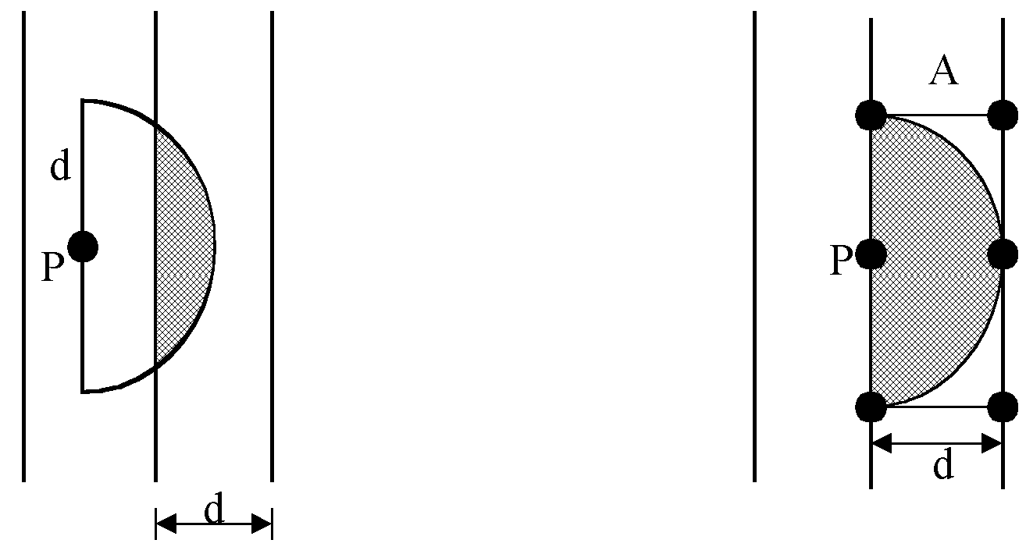
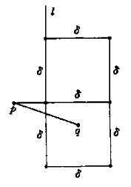
Closest Pair Problem:D&Q Algorithm for 2-D
at most 6 points in area A:
对于S_{L}虚框范围内的p点，在S_{R}虚框中与p点距离小于δ的顶多只有六个点，就是图二右图中的2个正方形的6的顶点。这个可以反推证明，如果右边这2个正方形内有7个点与p点距离小于δ，例如q点，则q点与下面正方形的四个顶点距离小于δ，则和δ为S_{L}和S_{R}中的最小点对距离相矛盾。因此对于S_{L}虚框中的p点，不需求出p点和右边虚线框内所有点距离，只需计算S_{R}中与p点y坐标距离最近的6个点，就可以求出最近点对，节省了比较次数。
（否则的话，最坏情形下，在S_{R}虚框中有可能会有n/2个点，对于S_{L}虚框中的p点，每次要比较n/2次，浪费了算法的效率）

Slide 29
Closest Pair Problem:D&Q Algorithm for 2-D
The algorithm:
Input: A set S of n planar points.
Output: The distance between two closest points.
Step 1: Sort points in S according to their y-values.
Step 2: If S contains only one point, return infinity as its distance.
Step 3: Find a median line L perpendicular to the X-axis to divide S into S_{L} and S_{R}, with equal sizes.
Step 4: Recursively apply Steps 2 and 3 to solve the closest pair problems of S_{L} and S_{R}. Let d_{L}(d_{R}) denote the distance between the closest pair in S_{L} (S_{R}). Let d = min(d_{L}, d_{R}).

Slide 30
Closest Pair Problem:D&Q Algorithm for 2-D
Step 5: For a point P in the half-slab bounded by L-d and L, let its y-value be denoted as y_{P} . For each such P, find all points in the half-slab bounded by L and L+d whose y-value fall within y_{P}+d and y_{P}-d. If the distance d′ between P and a point in the other half-slab is less than d, let d=d′. The final value of d is the answer.
Time complexity: O(n log n)
Step 1: O(n log n)
Steps 2~5:
⇒T(n) = O(n log n)
如果是三维呢？

Slide 31
4.5 Counting Inversions
Music site tries to match your song preferences with others.
You rank n songs.
Music site consults database to find people with similar tastes.
Similarity metric: number of inversions between two rankings.
My rank: 1, 2, …, n.
Your rank: a₁, a₂, …, a_{n}.
Songs i and j inverted if i < j, but a_{i} > a_{j}.
Brute force: check all Θ(n²) pairs i and j.
Songs
A
B
C
D
E
Me
1
2
3
4
5
Inversions
3-2, 4-2
You
1
3
4
2
5
Notes:
amazon.com, launch.com, restaurants, movies, . . .
Note: there can be a quadratic number of inversions.
Asymptotically faster algorithm must compute total number without even looking at each inversion individually.

Slide 32
Applications
Voting theory.
Collaborative filtering.
Measuring the "sortedness" of an array.
Sensitivity analysis of Google's ranking function.
Rank aggregation for meta-searching on the Web.
Nonparametric statistics (e.g., Kendall's Tau distance).

Slide 33
Counting Inversions: Divide-and-Conquer
Divide-and-conquer.
1
5
4
8
10
2
6
9
12
11
3
7

Slide 34
Counting Inversions: Divide-and-Conquer
Divide-and-conquer.
Divide: separate list into two pieces.
1
5
4
8
10
2
6
9
12
11
3
7
Divide: O(1).
1
5
4
8
10
2
6
9
12
11
3
7

Slide 35
Counting Inversions: Divide-and-Conquer
Divide-and-conquer.
Divide: separate list into two pieces.
Conquer: recursively count inversions in each half.
1
5
4
8
10
2
6
9
12
11
3
7
Divide: O(1).
1
5
4
8
10
2
6
9
12
11
3
7
Conquer: 2T(n / 2)
5 blue-blue inversions
8 green-green inversions
5-4, 5-2, 4-2, 8-2, 10-2
6-3, 9-3, 9-7, 12-3, 12-7, 12-11, 11-3, 11-7

Slide 36
Counting Inversions: Divide-and-Conquer
Divide-and-conquer.
Divide: separate list into two pieces.
Conquer: recursively count inversions in each half.
Combine: count inversions where a_{i} and a_{j} are in different halves, and return sum of three quantities.
1
5
4
8
10
2
6
9
12
11
3
7
Divide: O(1).
1
5
4
8
10
2
6
9
12
11
3
7
Conquer: 2T(n / 2)
5 blue-blue inversions
8 green-green inversions
9 blue-green inversions
5-3, 4-3, 8-6, 8-3, 8-7, 10-6, 10-9, 10-3, 10-7
Combine: ???
Total = 5 + 8 + 9 = 22.

Slide 37
Counting Inversions: Combine
Combine: count blue-green inversions
Assume each half is sorted.
Count inversions where a_{i} and a_{j} are in different halves.
Merge two sorted halves into sorted whole.
demo
to maintain sorted invariant
3
7
10
14
18
19
2
11
16
17
23
25
6
3
2
2
0
0
13 blue-green inversions: 6 + 3 + 2 + 2 + 0 + 0
Count: O(n)
2
3
7
10
11
14
16
17
18
19
23
25
Merge: O(n)
Notes:
void sort(vector<int>& nums, int l, int r){
if (r <= l) return;
int m = (l + r) >> 1;
sort(nums, l, m);
sort(nums, m + 1, r);
int i = l, j = m + 1;
while(j <= r){
while(i <= m && (double)nums[i] / 2 <= nums[j])
i++;
res += m - i + 1;
j++;
}
merge(nums, l, m, r);
}

Slide 38
Counting Inversions: Implementation
Pre-condition. [Merge-and-Count] A and B are sorted.
Post-condition. [Sort-and-Count] L is sorted.
Sort-and-Count(L) {
if list L has one element
return 0 and the list L
Divide the list into two halves A and B
(r_{A}, A) ← Sort-and-Count(A)
(r_{B}, B) ← Sort-and-Count(B)
(r_{B}, L) ← Merge-and-Count(A, B)
return r = r_{A} + r_{B} + r and the sorted list L
}
假设L可能执行删除，则删除前的逆序对？

Slide 39
4.6 Sort
Obviously application
Sort a list of names.
Organize an MP3 library.
Display Google PageRank results.
List RSS(Really Simple Syndication) news items in reverse chronological order.
Problems become easy once items are in sorted order
Find the median.
Find the closest pair.
Binary search in a database.
Identify statistical outliers.
Find duplicates in a mailing list.

Slide 40
Sort
Non-obvious applications
Data compression.
Computer graphics.
Computational biology.
Supply chain management.
Book recommendations on Amazon.
Load balancing on a parallel computer.
....

Slide 41
Merge Sort …

Slide 42
4.6.1 Merge sort
using divide and conquer technique
divide the sequence of n numbers into two halves
recursively sort the two halves
merge the two sorted halves into a single sorted sequence

Slide 43
51, 13, 10, 64, 34, 5, 32, 21
we want to sort these 8 numbers,
divide them into two halves

Slide 44
51, 13, 10, 64, 34, 5, 32, 21
51, 13, 10, 64
34, 5, 32, 21
divide these 4 numbers into halves
similarly for these 4

Slide 45
51, 13, 10, 64, 34, 5, 32, 21
51, 13, 10, 64
34, 5, 32, 21
51, 13
10, 64
34, 5
32, 21
further divide each shorter sequence …
until we get sequence with only 1 number

Slide 46
51, 13, 10, 64, 34, 5, 32, 21
51, 13, 10, 64
34, 5, 32, 21
51, 13
10, 64
34, 5
32, 21
51
13
10
64
34
5
32
21
merge pairs of single number into a sequence of 2 sorted numbers

Slide 47
51, 13, 10, 64, 34, 5, 32, 21
51, 13, 10, 64
34, 5, 32, 21
51, 13
10, 64
34, 5
32, 21
51
13
10
64
34
5
32
21
13, 51
10, 64
5, 34
21, 32
then merge again into sequences of 4 sorted numbers

Slide 48
51, 13, 10, 64, 34, 5, 32, 21
51, 13, 10, 64
34, 5, 32, 21
51, 13
10, 64
34, 5
32, 21
51
13
10
64
34
5
32
21
13, 51
10, 64
5, 34
21, 32
10, 13, 51, 64
5, 21, 32, 34
one more merge give the final sorted sequence

Slide 49
51, 13, 10, 64, 34, 5, 32, 21
51, 13, 10, 64
34, 5, 32, 21
51, 13
10, 64
34, 5
32, 21
51
13
10
64
34
5
32
21
13, 51
10, 64
5, 34
21, 32
10, 13, 51, 64
5, 21, 32, 34
5, 10, 13, 21, 32, 34, 51, 64

Slide 50
Summary
Divide
dividing a sequence of n numbers into two smaller sequences is straightforward
Conquer
merging two sorted sequences of total length n can also be done easily, at most n-1 comparisons

Slide 51
10, 13, 51, 64
5, 21, 32, 34
Result:
To merge two sorted sequences,
we keep two pointers, one to each sequence
Compare the two numbers pointed,
copy the smaller one to the result
and advance the corresponding pointer

Slide 52
10, 13, 51, 64
5, 21, 32, 34
Result:
5,
Then compare again the two numbers
pointed to by the pointer;
copy the smaller one to the result
and advance that pointer

Slide 53
10, 13, 51, 64
5, 21, 32, 34
Result:
5, 10,
Repeat the same process …

Slide 54
10, 13, 51, 64
5, 21, 32, 34
Result:
5, 10, 13
Again …

Slide 55
10, 13, 51, 64
5, 21, 32, 34
Result:
5, 10, 13, 21
and again …

Slide 56
10, 13, 51, 64
5, 21, 32, 34
Result:
5, 10, 13, 21, 32
…

Slide 57
10, 13, 51, 64
5, 21, 32, 34
Result:
5, 10, 13, 21, 32, 34
When we reach the end of one sequence,
simply copy the remaining numbers in the other sequence to the result

Slide 58
10, 13, 51, 64
5, 21, 32, 34
Result:
5, 10, 13, 21, 32, 34, 51, 64
Then we obtain the final sorted sequence

Slide 59
Pseudo code
Algorithm Mergesort(A[1..n])
if n > 1 then begin
copy A[1..⎣n/2⎦] to B[1..⎣n/2⎦]
copy A[⎣n/2⎦+1..n] to C[1..⎡n/2⎤]
Mergesort(B[1..⎣n/2⎦])
Mergesort(C[1..⎡n/2⎤])
Merge(B, C, A)
end

Slide 60
MS(
51, 13, 10, 64, 34, 5, 32, 21
)
MS(
51, 13, 10, 64
)
MS(
34, 5, 32, 21
)
MS(
51, 13
)
MS(
10, 64
)
MS(
34, 5
)
MS(
32, 21
)
MS(
51
13
10
64
MS(
34
5
32
21
)
MS(
MS(
MS(
MS(
)
MS(
MS(
)
)
)
)
)
)
M(
13, 51
,
10, 64
)
M(
5, 34
,
21, 32
)
M(
10, 13, 51, 64
,
5, 21, 32, 34
)
5, 10, 13, 21, 32, 34, 51, 64

Slide 61
MS(
51, 13, 10, 64, 34, 5, 32, 21
)
1
11
MS(
51, 13, 10, 64
)
MS(
34, 5, 32, 21
)
2
6
16
12
MS(
51, 13
)
MS(
10, 64
)
MS(
34, 5
)
MS(
32, 21
)
3
4
7
8
13
14
17
18
MS(
51
13
10
64
MS(
34
5
32
21
)
MS(
MS(
MS(
MS(
)
MS(
MS(
)
)
)
)
)
)
5
9
15
19
M(
13, 51
,
10, 64
)
M(
5, 34
,
21, 32
)
10
20
M(
10, 13, 51, 64
,
5, 21, 32, 34
)
21
5, 10, 13, 21, 32, 34, 51, 64
order of execution

Slide 62
Pseudo code
Algorithm Merge(B[1..p], C[1..q], A[1..p+q])
set i=1, j=1, k=1
while i<=p and j<=q do
begin
if B[i]≤C[j] then
set A[k] = B[i] and i = i+1
else set A[k] = C[j] and j = j+1
k = k+1
end
if i==p+1 then copy C[j..q] to A[k..(p+q)]
else copy B[i..p] to A[k..(p+q)]

Slide 63
Recurrence for merge sort
Θ(1) if n = 1;
T(n) =
2T(n/2) + Θ(n) if n > 1.
We shall usually omit stating the base case when T(n) = Θ(1) for sufficiently small n, but only when it has no effect on the asymptotic solution to the recurrence.
Master theorem can find a good upper bound on T(n).

Slide 64
Recursion tree
Solve T(n) = 2T(n/2) + cn, where c > 0 is constant.

Slide 65
Recursion tree
Solve T(n) = 2T(n/2) + cn, where c > 0 is constant.
T(n)

Slide 66
Recursion tree
Solve T(n) = 2T(n/2) + cn, where c > 0 is constant.
cn
T(n/2)
T(n/2)

Slide 67
Recursion tree
Solve T(n) = 2T(n/2) + cn, where c > 0 is constant.
cn
cn/2
cn/2
T(n/4)
T(n/4)
T(n/4)
T(n/4)

Slide 68
Recursion tree
Solve T(n) = 2T(n/2) + cn, where c > 0 is constant.
cn
cn/2
cn/2
cn/4
cn/4
cn/4
cn/4
…
Θ(1)

Slide 69
Recursion tree
Solve T(n) = 2T(n/2) + cn, where c > 0 is constant.
cn
cn/2
cn/2
h = lg n
cn/4
cn/4
cn/4
cn/4
…
Θ(1)

Slide 70
Recursion tree
Solve T(n) = 2T(n/2) + cn, where c > 0 is constant.
cn
cn
cn/2
cn/2
h = lg n
cn/4
cn/4
cn/4
cn/4
…
Θ(1)

Slide 71
Recursion tree
Solve T(n) = 2T(n/2) + cn, where c > 0 is constant.
cn
cn
cn/2
cn/2
cn
h = lg n
cn/4
cn/4
cn/4
cn/4
…
Θ(1)

Slide 72
Recursion tree
Solve T(n) = 2T(n/2) + cn, where c > 0 is constant.
cn
cn
cn/2
cn/2
cn
h = lg n
cn/4
cn/4
cn/4
cn/4
cn
…
…
Θ(1)

Slide 73
Recursion tree
Solve T(n) = 2T(n/2) + cn, where c > 0 is constant.
cn
cn
cn/2
cn/2
cn
h = lg n
cn/4
cn/4
cn/4
cn/4
cn
…
…
Θ(1)
#leaves = n
Θ(n)

Slide 74
Recursion tree
Solve T(n) = 2T(n/2) + cn, where c > 0 is constant.
cn
cn
cn/2
cn/2
cn
h = lg n
cn/4
cn/4
cn/4
cn/4
cn
…
…
Θ(1)
#leaves = n
Θ(n)
Total = Θ(n lg n)

Slide 75
Time complexity
Prove that is O(n log n)
Make a guess: T(n) ≤ 2 n log n
Assume true for all n'<n [assume T(n/2) ≤ 2 (n/2) log(n/2)]
T(n) = 2×T(n/2)+n
≤ 2 × (2×(n/2)xlog(n/2)) + n
= 2 n (log n - 1) + n
= 2 n log n - 2n + n
≤ 2 n log n
1 if n=1
2×T(n/2) + n otherwise
T(n) =
by hypothesis
i.e., T(n) ≤ 2 n log n
How about the base case?

Slide 76
Example
1 if n=1
T(n/2) + 1 otherwise
T(n) =
Guess: T(n) ≤ 2 log n
For the base case when n=2,
L.H.S = T(2) = T(1) + 1 = 2
R.H.S = 2 log 2 = 2
L.H.S ≤ R.H.S

Slide 77
Example
1 if n=1
T(n/2) + 1 otherwise
T(n) =
Guess: T(n) ≤ 2 log n
Assume true for all n' < n [assume T(n/2) ≤ 2 x log (n/2)]
T(n) = T(n/2) + 1
≤ 2 x log(n/2) + 1 ← by hypothesis
= 2x(log n – 1) + 1 ← log(n/2) = log n – log 2
< 2log n
i.e., T(n) ≤ 2 log n

Slide 78
More example
1 if n=1
2×T(n/2) + 1 otherwise
Prove that is O(n)
Guess: T(n) ≤ 2n – 1
T(n) =
For the base case when n=1, L.H.S = T(1) = 1
R.H.S = 2×1 - 1 = 1 L.H.S ≤ R.H.S

Slide 79
More example
1 if n=1
2×T(n/2) + 1 otherwise
T(n) =
Prove that is O(n)
Guess: T(n) ≤ 2n – 1
Assume true for all n' < n [assume T(n/2) ≤ 2(n/2)-1]
T(n) = 2×T(n/2)+1
≤ 2 × (2×(n/2)-1) + 1 ← by hypothesis
= 2n – 2 + 1
= 2n - 1
i.e., T(n) ≤ 2n-1

Slide 80
Time complexity of the general algorithm
Depending on the recurrence, we can guess the order of growth
T(n) = T(n/2)+1 T(n) is O(log n)
T(n) = 2×T(n/2)+1 T(n) is O(n)
T(n) = 2×T(n/2)+n T(n) is O(n log n)
T(n) = 2×T(n-1)+1 T(n) is O(2^{n})

Slide 81
5.6.2 QuickSort (a) Methodology
Invented by Tony Hoare in 1962
Recursive Divide-And-Conquer
Partitions array around a Pivot , then sorts the two sub-arrays independently
No need to merge the two sub-arrays
Fast sorting

Slide 82
(a) Methodology
p
q
r
 |  |  | pivot
Left
Right
Divide:
Array a[p..r] is rearranged into a sub-array a[p..q-1], a pivot a[q] and a second sub-array a[q+1..r] such that each element of the first is <= pivot and each element of the second is >= pivot ( the pivot index (q) is computed as part of this process)

Slide 83
Methodology (continued)
Conquer:
Sort the two sub-arrays recursively
Combine:
The sub-arrays are already sorted in place, i.e., a[p..r] is sorted.

Slide 84
(b) Algorithm
QuickSort (a, p , r)
// Sorts the elements a[p],..., a[r] which reside in
// the global array a[1:n] into ascending order;
// a[n+1] is considered to be defined and must be >= all the
// elements in a[1:n].
{
if (p < r ) { // If there are more than one element
q = partition (a , p , r+1); // partition around Pivot
// q is the position of the pivot
QuickSort (a , p ,q-1); // Sort left sub-array
QuickSort (a , q+1 , r); // Sort Right sub-array
}
}

Slide 85
Partitioning
int partition(a, p, r)
{
pivot = a_{p}; // pivot is initially the first element
i = p; j = r;
do
{
do {i++; } while (a_{i} < pivot);
do {j--; } while (a_{j} > pivot);
if(i < j) swap (a_{i} , a_{j});
} while (i < j);
a_{p} = a_{j}; a_{j} = pivot;
return (j);
// j is the final location of the pivot
}
Any error?

Slide 86
Quick Sort Demo

Slide 87
(c)Analysis of QuickSort
Partitioning will cost (n) comparisons. Sorting costs T(i) for left
sub-array + pivot, T(n-i) for right sub-array. Hence:
T(n) = n + T(i) + T(n-i) for n > 1 with T(1) = 0
partition cost = n
i elements
n-i elements

Slide 88
Best Case
Best Case when pivot has the middle value. In this case, the array is partitioned into two almost equal halves.
T(n) = 2T(n/2) + n for n > 1 with T(1) = 0
hence, T(n) = O(n log n)
partition cost = n
n/2 elements
n/2 elements

Slide 89
Worst Case
Worst Case when pivot is the smallest element so that i = 1
T(n) = T(n-1) + n for n > 1
with T(1) = 0
Hence, T(n) = n(n+1)/2 -1= O(n²)
In this case, Quicksort is not really quick!
partition cost = n
1
n-1 elements

Slide 90
Average Case Analysis
If the pivot is randomly chosen using a random number generator, we have (n-1) equally probable configurations:
{1,n-1},{2,n-2},..., {i, n-i},..{n-2,2},{n-1,1}
The probability of each configuration is 1/(n-1)
We obtain an average case cost given by:

Slide 91
Average Case Analysis

Slide 92
Average Case Analysis

Slide 93
Summary of Performance of QuickSort
Partitioning will cost O(n) at each level
Best Case: Pivot has the middle value
Quicksort divides the array to two equal halves at each level. So, the number of levels is O(log n)
Therefore, the complexity of QuickSort is O(n log n)
Worst Case: Pivot is the minimum (maximum) value
The number of levels is O(n)
Therefore, the complexity of QuickSort is O(n²)
In-Place Sort No
Stable Algorithm No
This technique is satisfactory for large data sets

Slide 94
Median-of-Three Partitioning
If we take the elements in the first, last and middle locations in the array and then take the element middle in value between these three, this will be the median of three. In this case, there is always at least one element below and one element above. The worst case is therefore unlikely

Slide 95
A Better Choice: Random Pivot
A better solution that avoids the worst case of O(n²) is to use a randomizer to select the pivot element.
Pick a random element from the sub-array (p..r) as the partition element.
Do this only if (r-p) > 5 to avoid cost of the randomizer

Slide 96
A Better Choice: Random Pivot
void RQuickSort (a , p , r)
{
if (p < r )
{
if ((r-p) > 5)
{ int m = rand()%(r-p+1) + p;
swap (a_{p} , a_{m});
}
q = partition(a , p , r+1);
RQuickSort(a , p ,q-1);
RQuickSort(a , q+1 , r);
}
}
Any consideration?

Slide 97
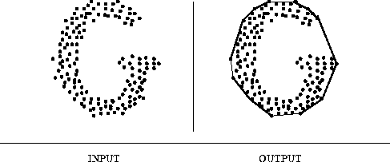
4.7 Convex Hull
The Problem:
Given a set S of n points in 2-dimensional space, find
the smallest convex polygon containing all the points of
S.

Slide 98
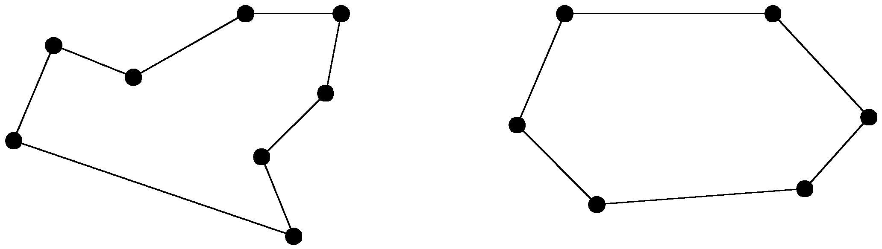
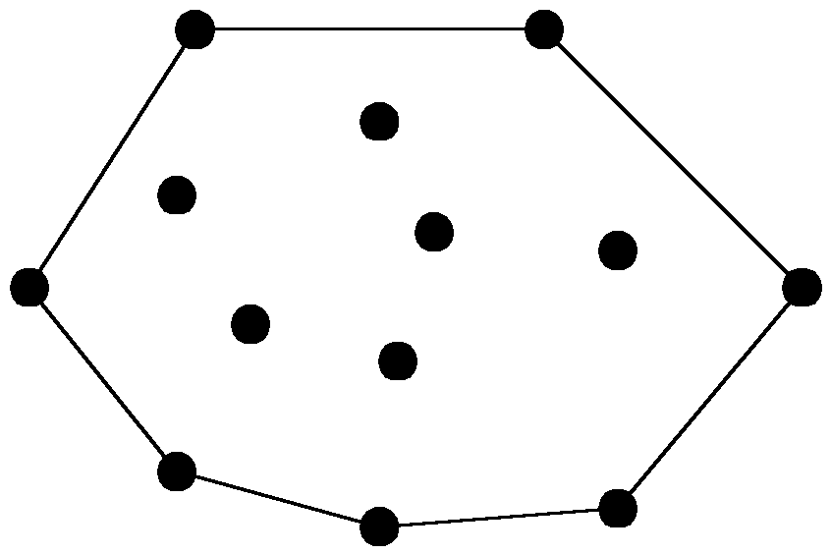
The convex hull problem
concave polygon:
convex polygon:
The convex hull of a set of planar points is the smallest convex polygon containing all of the points.

Slide 99
Convex Hull
The convex hull of a set of points is an elementary problem in computational geometry.
The hull gives a rough idea of the shape or extent of a data set.
It is an important step for various geometric algorithms. For example, finding the diameter of a set of points.
A famous algorithm is the Graham Scan
Notes:
1. 在所有点中选取y坐标最小的一点H，当作基点。如果存在多个点的y坐标都为最小值，则选取x坐标最小的一点。坐标相同的点应排除。然后按照其它各点p和基点构成的向量<H,p>与x轴的夹角进行排序，夹角由大至小进行顺时针扫描，反之则进行逆时针扫描。实现中无需求得夹角，只需根据向量的内积公式求出向量的模即可。以下图为例，基点为H，根据夹角由小至大排序后依次为H，K，C，D，L，F，G，E，I，B，A，J。下面进行逆时针扫描。
2. 线段<H, K>一定在凸包上，接着加入C。假设线段<K, C>也在凸包上，因为就H，K，C三点而言，它们的凸包就是由此三点所组成。但是接下来加入D时会发现，线段<K, D>才会在凸包上，所以将线段<K, C>排除，C点不可能是凸包。
3. 即当加入一点时，必须考虑到前面的线段是否会出现在凸包上。从基点开始，凸包上每条相临的线段的旋转方向应该一致，并与扫描的方向相反。如果发现新加的点使得新线段与上线段的旋转方向发生变化，则可判定上一点必然不在凸包上。实现时可用向量叉积进行判断，设新加入的点为p_{n + 1}，上一点为p_{n}，再上一点为p_{n - 1}。顺时针扫描时，如果向量<p_{n - 1}, p_{n}>与<p_{n}, p_{n + 1}>的叉积为正（逆时针扫描判断是否为负），则将上一点删除。删除过程需要回溯，将之前所有叉积符号相反的点都删除，然后将新点加入凸包。
在上图中，加入K点时，由于线段<H,K>相对于<H,C>为顺时针旋转，所以C点不在凸包上，应该删除，保留K点。接着加入D点，由于线段<K, D>相对<H, K>为逆时针旋转，故D点保留。按照上述步骤进行扫描，直到点集中所有的点都遍例完成，即得到凸包。
复杂度
这个算法可以直接在原数据上进行运算，因此空间复杂度为O(1)。但如果将凸包的结果存储到另一数组中，则可能在代码级别进行优化。由于在扫描凸包前要进行排序，因此时间复杂度至少为快速排序的O(nlgn)。后面的扫描过程复杂度为O(n)，因此整个算法的复杂度为O(nlgn)。

Slide 100
Divide-and-Conquer for Convex Hull
Input : A set S of planar points
Output : A convex hull for S
Step 1: If S contains no more than five points, use exhaustive searching to find the convex hull and return.
Step 2: Find a median line perpendicular to the X-axis which divides S into S_{L} and S_{R}, with equal sizes.
Step 3: Recursively construct convex hulls for S_{L} and S_{R}, denoted as Hull(S_{L}) and Hull(S_{R}), respectively.
Step 4: Apply the merging procedure to merge Hull(S_{L}) and Hull(S_{R}) together to form a convex hull.

Slide 101
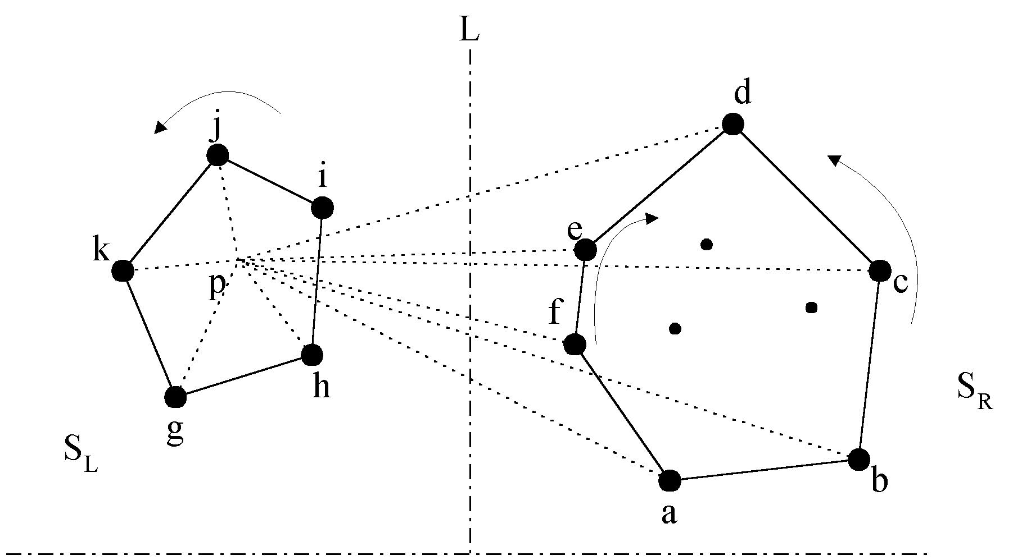
Divide-and-Conquer for Convex Hull
The divide-and-conquer strategy to solve the problem:

Slide 102
Divide-and-Conquer for Convex Hull
The merging procedure:
Select an interior point p.
There are 3 sequences of points which have increasing polar angles with respect to p.
(1) g, h, i, j, k
(2) a, b, c, d
(3) f, e
Merge these 3 sequences into 1 sequence:
g, h, a, b, f, c, e, d, i, j, k.
Apply Graham scan to examine the points one by one and eliminate the points which cause reflexive angles.
(See the example on the next page.)
Notes:
#include <iostream> #include <math.h> using namespace std; typedef struct{double x,y;} Point; void qsortpoint(Point s[],Point base,int start,int end); void sortstartedge(Point s[],int nums); //向量（x1,y1）,(x2,y2)的叉积 double CrossMul(double x1,double y1,double x2,double y2) { return x1*y2-x2*y1; } //向量（x1,y1）,(x2,y2)的点积 double DotMul(double x1,double y1,double x2,double y2) { return x1*x2+y1*y2; } //跨立判断 //判断点c是在向量ab的逆时针方向还是顺时针方向，大于零逆时针，等于0则共线 double CrossMul(Point a,Point b,Point c) { return CrossMul(b.x-a.x,b.y-a.y,c.x-a.x,c.y-a.y); } //计算向量ab和ac点积 double DotMul(Point a,Point b,Point c) { return DotMul(b.x-a.x,b.y-a.y,c.x-a.x,c.y-a.y); } //判断浮点数符号 int doublecmp(double d) { if(fabs(d)<10e-6) return 0; return d>0?1:-1; } //判断同一直线上的三个点位置，点c是否在点ab之间 bool betweenCmp(Point a,Point b,Point c) { if(doublecmp(DotMul(c,a,b))<=0) return true; return false; } //判断j是否在base->i向量的左边或当共线时j是否位于它们的线段之间 bool isLeftorNearer(Point base,Point i,Point j) { if(CrossMul(base,i,j)>0) return true; if(CrossMul(base,i,j)==0 && betweenCmp(base,i,j)) return true; return false; } void swap(Point& a,Point& b) { Point temp = b; b=a; a=temp; } //以s中的最低点为参考点，对其他所有点进行极角排序（逆时针） //共线时离参考点较远的点排在前面，凸包的起始边共线点从近到远排列 void sortpoint(Point s[],int nums) { //找最低点 for(int i=1;i<nums;i++) { if(s[i].y<s[0].y || (s[i].y==s[0].y && s[i].x<s[0].x)) swap(s[0],s[i]); } qsortpoint(s,s[0],1,nums); //将起始边上的共线点重新排列 sortstartedge(s,nums); } void sortstartedge(Point s[],int nums) { int i,j; for(i=2;i<nums;i++) { if(CrossMul(s[0],s[1],s[i])!=0) break; } for(j=1;j<(i+1)/2;j++) swap(s[j],s[i-j]); }
//将点按极角逆时针排序 void qsortpoint(Point s[],Point base,int start,int end) { if(start>=end) return; Point partition = s[end-1]; int i=start-1,j=start-1; while(++j<end-1) { if(isLeftorNearer(base,s[j],partition)) { swap(s[++i],s[j]); } } swap(s[++i],s[end-1]); qsortpoint(s,base,start,i); qsortpoint(s,base,i+1,end); } void ConvexHull(Point s[],int nums,Point result[],int& resultnums) { sortpoint(s,nums);
resultnums = 0; if(nums<=3) { for(int i=0;i<nums;i++) result[resultnums++] = s[i]; return; } int top=0; int i; for(i=0;i<2;i++) result[top++] = s[i]; while(i<nums) { //用<号判断则包含凸包边上的共线点，<=号判断则只包含凸包顶点 if(CrossMul(result[top-2],result[top-1],s[i])<=0) { top--; } else { result[top++] = s[i++]; } } //最后加入起点形成闭包 while(CrossMul(result[top-2],result[top-1],s[0])<=0) { top--; } result[top++]=s[0]; resultnums = top; } int main() { Point pa[] = {{0,0},{1,0},{2,0},{3,0},{4,0}, {4,1},{4,2},{4,3},{4,4}, {3,4},{2,4},{1,4},{0,4}, {0,3},{0,2},{0,1},{2,2},{1,1}}; cout<<"convex hull is:"<<endl; Point result[18]; int nums; ConvexHull(pa,18,result,nums); for(int i=0;i<nums;i++) cout<<result[i].x <<"," <<result[i].y<<endl; return 0; }

Slide 103
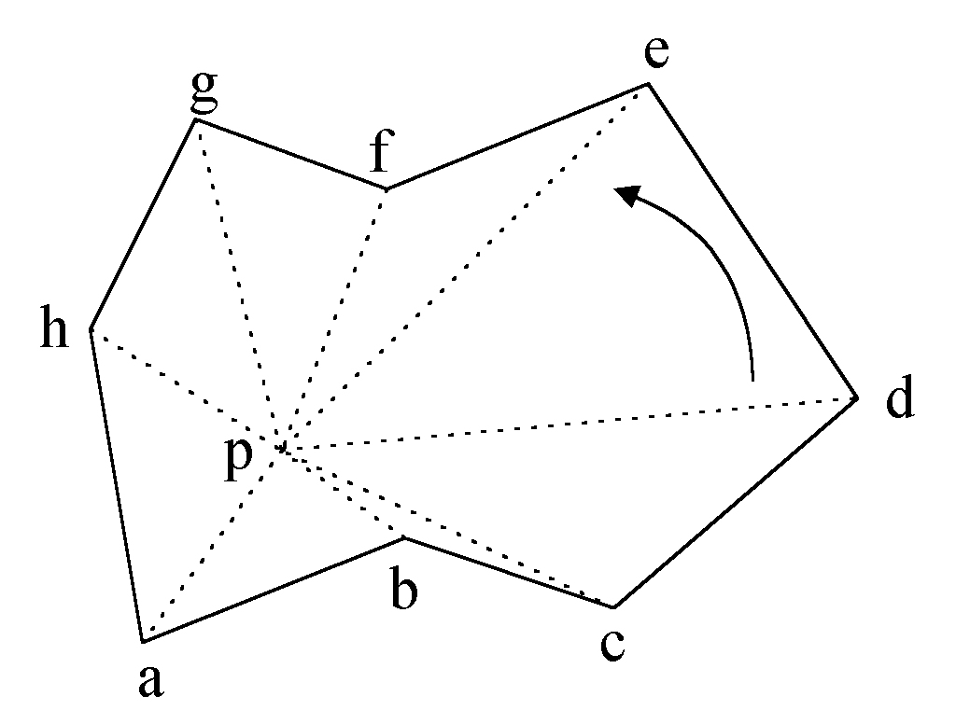
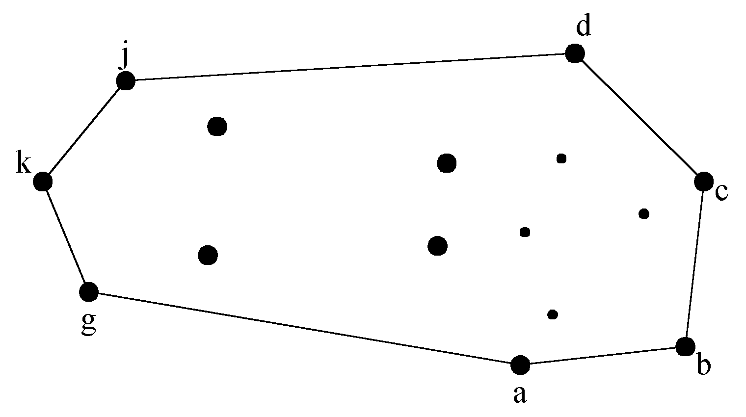
Divide-and-Conquer for Convex Hull
e.g. points b and f need to be deleted.
Final result:

Slide 104
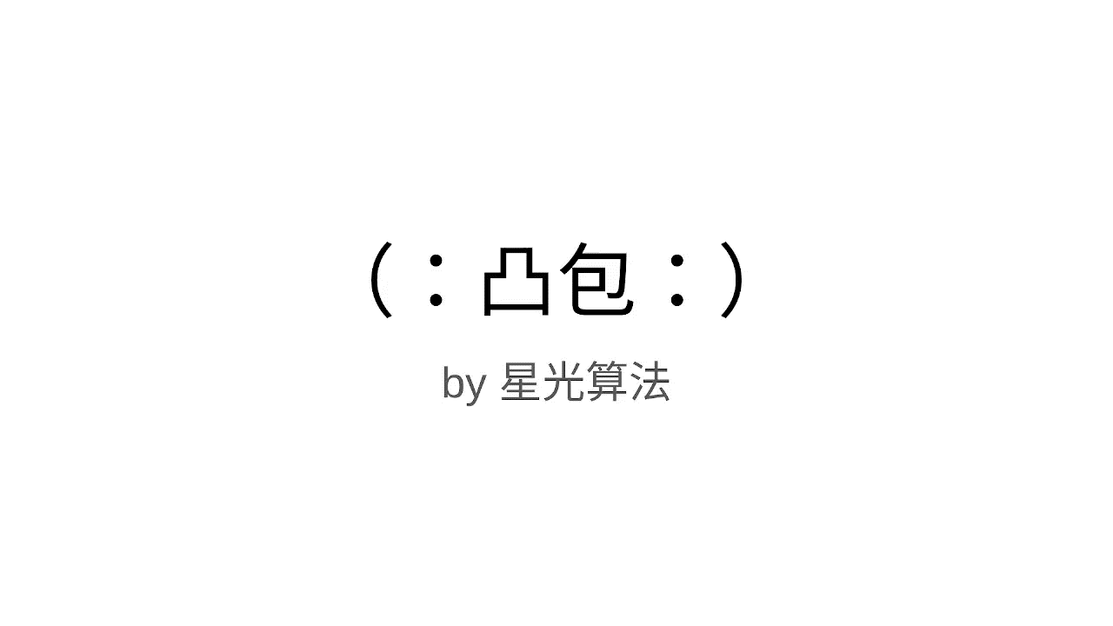
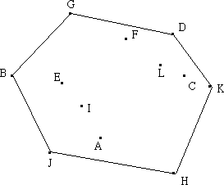
Graham Scan
在所有点中选取y坐标最小的一点H，当作基点。如果存在多个点的y坐标都为最小值，则选取x坐标最小的一点。坐标相同的点应排除。然后按照其它各点p和基点构成的向量<H,p>与x轴的夹角进行排序，夹角由大至小进行顺时针扫描，反之则进行逆时针扫描。实现中无需求得夹角，只需根据向量的内积公式求出向量的模即可。以下图为例，基点为H，根据夹角由小至大排序后依次为H，K，C，D，L，F，G，E，I，B，A，J。下面进行逆时针扫描。

Slide 105
Graham Scan
线段<H, K>一定在凸包上，接着加入C。假设线段<K, C>也在凸包上，因为就H，K，C三点而言，它们的凸包就是由此三点所组成。但是接下来加入D时会发现，线段<K, D>才会在凸包上，所以将线段<K, C>排除，C点不可能是凸包。

Slide 106
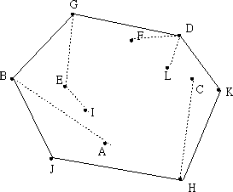
Graham Scan
当加入一点时，必须考虑到前面的线段是否会出现在凸包上。从基点开始，凸包上每条相临的线段的旋转方向应该一致，并与扫描的方向相反。如果发现新加的点使得新线段与上线段的旋转方向发生变化，则可判定上一点必然不在凸包上。实现时可用向量叉积进行判断，设新加入的点为p_{n + 1}，上一点为p_{n}，再上一点为p_{n - 1}。顺时针扫描时，如果向量<p_{n - 1}, p_{n}>与<p_{n}, p_{n + 1}>的叉积为正（逆时针扫描判断是否为负），则将上一点删除。删除过程需要回溯，将之前所有叉积符号相反的点都删除，然后将新点加入凸包。

Slide 107
Graham Scan
加入C点时，由于线段<H,K>相对于<H,C>为顺时针旋转，所以C点不在凸包上，应该删除，保留K点。接着加入D点，由于线段<K, D>相对<H, K>为逆时针旋转，故D点保留。按照上述步骤进行扫描，直到点集中所有的点都遍例完成，即得到凸包。

Slide 108
Graham Scan Algorithm
void GScan (pointList S)
{
// p is the start point in S
//(p1 , p2 , p3) is a point triplet
// A is the signed area of the triangle
// formed by the point triplet
set p1 = p;
do {
p2 = succ(p1);
if (p2 is not the last point) then p3 = succ(p2);
else p3 = p;
Notes:
#include <algorithm>
#include <iostream>
#include <vector>
#include <math.h>
using namespace std;
//二维点(或向量)结构体定义
#ifndef _WINDEF_
struct POINT { int x; int y; };
#endif
typedef vector<POINT> PTARRAY;
//判断两个点(或向量)是否相等
bool operator==(const POINT &pt1, const POINT &pt2) {
return (pt1.x == pt2.x && pt1.y == pt2.y);
}
// 比较两个向量pt1和pt2分别与x轴向量(1, 0)的夹角
bool CompareVector(const POINT &pt1, const POINT &pt2) {
//求向量的模
float m1 = sqrt((float)(pt1.x * pt1.x + pt1.y * pt1.y));
float m2 = sqrt((float)(pt2.x * pt2.x + pt2.y * pt2.y));
//两个向量分别与(1, 0)求内积
float v1 = pt1.x / m1, v2 = pt2.x / m2;
return (v1 > v2 || (v1 == v2 && m1 < m2));
}
//计算凸包
void CalcConvexHull(PTARRAY &vecSrc) {
//点集中至少应有3个点，才能构成多边形
if (vecSrc.size() < 3) {
return;
}
//查找基点
POINT ptBase = vecSrc.front(); //将第1个点预设为最小点
for (PTARRAY::iterator i = vecSrc.begin() + 1; i != vecSrc.end(); ++i) {
//如果当前点的y值小于最小点，或y值相等，x值较小
if (i->y < ptBase.y || (i->y == ptBase.y && i->x > ptBase.x)) {
//将当前点作为最小点
ptBase = *i;
}
}
//计算出各点与基点构成的向量
for (PTARRAY::iterator i = vecSrc.begin(); i != vecSrc.end();) {
//排除与基点相同的点，避免后面的排序计算中出现除0错误
if (*i == ptBase) {
i = vecSrc.erase(i);
}
else {
//方向由基点到目标点
i->x -= ptBase.x, i->y -= ptBase.y;
++i;
}
}
//按各向量与横坐标之间的夹角排序
sort(vecSrc.begin(), vecSrc.end(), &CompareVector);
//删除相同的向量
vecSrc.erase(unique(vecSrc.begin(), vecSrc.end()), vecSrc.end());
//计算得到首尾依次相联的向量
for (PTARRAY::reverse_iterator ri = vecSrc.rbegin();
ri != vecSrc.rend() - 1; ++ri) {
PTARRAY::reverse_iterator riNext = ri + 1;
//向量三角形计算公式
ri->x -= riNext->x, ri->y -= riNext->y;
}
//依次删除不在凸包上的向量
for (PTARRAY::iterator i = vecSrc.begin() + 1; i != vecSrc.end(); ++i) {
//回溯删除旋转方向相反的向量，使用外积判断旋转方向
for (PTARRAY::iterator iLast = i - 1; iLast != vecSrc.begin();) {
int v1 = i->x * iLast->y, v2 = i->y * iLast->x;
//如果叉积小于0，则无没有逆向旋转
//如果叉积等于0，还需判断方向是否相逆
if (v1 < v2 || (v1 == v2 && i->x * iLast->x > 0 &&
i->y * iLast->y > 0)) {
break;
}
//删除前一个向量后，需更新当前向量，与前面的向量首尾相连
//向量三角形计算公式
i->x += iLast->x, i->y += iLast->y;
iLast = (i = vecSrc.erase(iLast)) - 1;
}
}
//将所有首尾相连的向量依次累加，换算成坐标
vecSrc.front().x += ptBase.x, vecSrc.front().y += ptBase.y;
for (PTARRAY::iterator i = vecSrc.begin() + 1; i != vecSrc.end(); ++i) {
i->x += (i - 1)->x, i->y += (i - 1)->y;
}
//添加基点，全部的凸包计算完成
vecSrc.push_back(ptBase);
}
int main(void) {
int nPtCnt = 100; //生成的随机点数
PTARRAY vecSrc, vecCH;
for (int i = 0; i < nPtCnt; ++i) {
POINT ptIn = { rand() % 20, rand() % 20 };
vecSrc.push_back(ptIn);
cout << ptIn.x << ", " << ptIn.y << endl;
}
CalcConvexHull(vecSrc);
cout << "\nConvex Hull:\n";
for (PTARRAY::iterator i = vecSrc.begin(); i != vecSrc.end(); ++i) {
cout << i->x << ", " << i->y << endl;
}
return 0;
}

Slide 109
Graham Scan Algorithm
A = Area(p1 , p2 , p3); // signed area
// if p1,p2,p3 form a left turn
// move one point ahead;
// if not, delete p2 and move back.
if (A >= 0.0) p1 = succ(p1); // left turn
else { // right turn
delete p2;
p1 = pred(p1);
}
} while (!((p3 == p) && (A >= 0.0)));
}

Slide 110
Graham Scan Algorithm
An implementation of the Graham scan algorithm is given in the Book, p. 187
It uses a doubly linked list to represent the sorted point list.
The scan algorithm runs in O(n) time.
Since sorting takes O(n log n) time, the total time of Graham scan algorithm is
O(n log n)

Slide 111
4.8 Selection by Partitioning
The Selection Problem
Let A be an array of n distinct elements. Find
the k^{th} smallest element.
Some Applications
Finding nearest neighbor
Finding the Median
Partition around median for closest pair problem
Traveling salesman problem

Slide 112
Selection by Partitioning
Algorithms
Several algorithms exist.
One efficient algorithm uses partitioning around a pivot like Quicksort.
It is a Divide and Conquer algorithm with an average cost of O(n).

Slide 113
Selection by Partitioning
Let A be an array of n distinct elements. Find the k^{th} smallest element from
location p through location r.
Type select (Type A[ ], p, r, k)
{
if (p == r) return A[p];
else
{
//Choose a pivot (v) from A and partition A around (v)
// Let A1, A2 be the elements of A which are respectively <,> v
q = partition (A, p, r+1); // new pivot location
// A1 = elements from p to q-1, A2 = elements from q+1 to r
if (k = =q) return A[q];
else if (k < q) return select (A, p, q-1, k);
else return select (A, q+1, r, k − q);
}
}
invoke as select (A, 1, n, k)

Slide 114
Selection by Partitioning
1
j
q
j+2
n
A1 | v | A2
cost =T(j)
when
k <= j
i.e.
j = k .. n-1
cost =T(n-j-1)
when
k > j+1
i.e.
j = 0..k-2
partition
cost = n

Slide 115
Selection by Partitioning
Analysis:
The cost of partitioning is O(n)
Let |A1| = j and |A2| = n-j-1
The pivot position is q = j+1 with j = 0..n-1
We call select on A1 when k <= j, i.e. in the cases of j = k...n-1
We call select on A2 when k > j+1, i.e. in the cases of j = 0 .. k-2
Each case happens with equal probability (1/n)
Hence the average cost will be:

Slide 116
Average Case Analysis

Slide 117
If Selection using a BST
Type select (Type A[ ], int n, int k)
{
Type Amin;
binaryTree<Type, int> BST;
for (int i = 0; i<n; i++) BST.insert(A[i],0);
for (i = 1; i < k; i++) { Amin = BST.min(); BST.remove(Amin);}
return BST.min();
}
invoke as select (A, n, k)
Analysis
Insert n elements O(n log n)
Find and delete (k-1) minima O((k-1) log n)
Find kth min O(log n)
Total O((k+n) log n)

Slide 118
4.9 最大子段和问题
给定由n个整数组成的序列(a₁, a₂, …, a_{n})，最大子段和问题要求该序列形如 的最大值（1≤i≤j≤n），当序列中所有整数均为负整数时，其最大子段和为0。例如，序列(-20, 11, -4, 13, -5, -2)的最大子段和为：
最大子段和问题的分治策略是：
（1）划分：按照平衡子问题的原则，将序列(a₁, a₂, …, a_{n})划分成长度相同的两个子序列(a₁, …, a )和(a _{＋1}, …, a_{n})，则会出现以下三种情况：

Slide 119
最大子段和问题
① a₁, …, a_{n}的最大子段和＝a₁, …,a 的最大子段和；
② a₁, …, a_{n}的最大子段和＝a _{＋1}, …, a_{n}的最大子段和；
③ a₁, …, a_{n}的最大子段和＝ ，且
（2）求解子问题：对于划分阶段的情况①和②可递归求解，情况③需要分别计算 ，
，则s1+s2为情况③的最大子段和。
（3）合并：比较在划分阶段的三种情况下的最大子段和，取三者之中的较大者为原问题的解。

Slide 120
最大子段和问题
a₁ … … a_{i} … a_{mid} a_{mid+1}… a_{j} … … a_{n} 划分
leftsum rightsum 递归处理
max{leftsum, sum, rightsum} 合并解
sum 不能递归处理
a₁ … … a_{i} … a_{mid} a_{mid+1}… a_{j} … … a_{n} 最大子段和横跨两个子序列

Slide 121
最大子段和问题
C++描述
算法——最大子段和问题
int MaxSum(int a[ ], int left, int right)
{
sum=0;
if (left= =right) { //如果序列长度为1，直接求解
if (a[left]>0) sum=a[left];
else sum=0;
}
else {
center=(left+right)/2; //划分
leftsum=MaxSum(a, left, center);
//对应情况①，递归求解
rightsum=MaxSum(a, center+1, right);
//对应情况②，递归求解

Slide 122
最大子段和问题
s1=0; lefts=0; //以下对应情况③，先求解s1
for (i=center; i>=left; i--)
{
lefts+=a[i];
if (lefts>s1) s1=lefts;
}
s2=0; rights=0; //再求解s2
for (j=center+1; j<=right; j++)
{
rights+=a[j];
if (rights>s2) s2=rights;
}
sum=s1+s2; //计算情况③的最大子段和
if (sum<leftsum) sum=leftsum;
//合并，在sum、leftsum和rightsum中取较大者
if (sum<rightsum) sum=rightsum;
}
return sum;
}

Slide 123
最大子段和问题
分析算法的时间性能，对应划分得到的情况①和②，需要分别递归求解，对应情况③，两个并列for循环的时间复杂性是O(n)，所以，存在如下递推式：
根据主定理，算法的时间复杂性为O(nlog₂n)。

Slide 124
棋盘覆盖问题
在一个2^{k}×2^{k} （k≥0）个方格组成的棋盘中，恰有一个方格与其他方格不同，称该方格为特殊方格。棋盘覆盖问题要求用图（b）所示的4种不同形状的L型骨牌覆盖给定棋盘上除特殊方格以外的所有方格，且任何2个L型骨牌不得重叠覆盖。
(a) k=2时的一种棋盘 (b) 4种不同形状的L型骨牌

Slide 125
分治法求解棋盘覆盖问题的技巧在于划分棋盘，使划分后的子棋盘的大小相同，并且每个子棋盘均包含一个特殊方格，从而将原问题分解为规模较小的棋盘覆盖问题。
k>0时，可将2^{k}×2^{k}的棋盘划分为4个2^{k-1}×2^{k-1}的子棋盘，这样划分后，由于原棋盘只有一个特殊方格，所以，这4个子棋盘中只有一个子棋盘包含该特殊方格，其余3个子棋盘中没有特殊方格。为了将这3个没有特殊方格的子棋盘转化为特殊棋盘，以便采用递归方法求解，可以用一个L型骨牌覆盖这3个较小棋盘的会合处，从而将原问题转化为4个较小规模的棋盘覆盖问题。递归地使用这种划分策略，直至将棋盘分割为1×1的子棋盘。

Slide 126
2^{k-1}×2^{k-1}
2^{k-1}×2^{k-1}
2^{k-1}×2^{k-1}
2^{k-1}×2^{k-1}
(a)棋盘分割 (b) 构造相同子问题

Slide 127
下面讨论棋盘覆盖问题中数据结构的设计。
（1）棋盘：可以用一个二维数组board[size][size]表示一个棋盘，其中，size=2^{k}。为了在递归处理的过程中使用同一个棋盘，将数组board设为全局变量；
（2）子棋盘：整个棋盘用二维数组board[size][size]表示，其中的子棋盘由棋盘左上角的下标tr、tc和棋盘大小s表示；
（3）特殊方格：用board[dr][dc]表示特殊方格，dr和dc是该特殊方格在二维数组board中的下标;
（4） L型骨牌：一个2^{k}×2^{k}的棋盘中有一个特殊方格，所以，用到L型骨牌的个数为(4^{k}-1)/3，将所有L型骨牌从1开始连续编号，用一个全局变量t表示。

Slide 128
tc
tr
dc
dr
size
棋盘覆盖问题中的数据结构

Slide 129
C++描述
算法—棋盘覆盖
void ChessBoard(int tr, int tc, int dr, int dc, int size)
// tr和tc是棋盘左上角的下标，dr和dc是特殊方格的下标，
// size是棋盘的大小，t已初始化为0
{
if (size = = 1) return; //棋盘只有一个方格且是特殊方格
t++; // L型骨牌号
s = size/2; // 划分棋盘
// 覆盖左上角子棋盘
if (dr < tr + s && dc < tc + s) // 特殊方格在左上角子棋盘中
ChessBoard(tr, tc, dr, dc, s); //递归处理子棋盘
else{ // 用 t 号L型骨牌覆盖右下角，再递归处理子棋盘
board[tr + s - 1][tc + s - 1] = t;
ChessBoard(tr, tc, tr+s-1, tc+s-1, s);
}

Slide 130
// 覆盖右上角子棋盘
if (dr < tr + s && dc >= tc + s) // 特殊方格在右上角子棋盘中
ChessBoard(tr, tc+s, dr, dc, s); //递归处理子棋盘
else { // 用 t 号L型骨牌覆盖左下角，再递归处理子棋盘
board[tr + s - 1][tc + s] = t;
ChessBoard(tr, tc+s, tr+s-1, tc+s, s); }
// 覆盖左下角子棋盘
if (dr >= tr + s && dc < tc + s) // 特殊方格在左下角子棋盘中
ChessBoard(tr+s, tc, dr, dc, s); //递归处理子棋盘
else { // 用 t 号L型骨牌覆盖右上角，再递归处理子棋盘
board[tr + s][tc + s - 1] = t;
ChessBoard(tr+s, tc, tr+s, tc+s-1, s); }
// 覆盖右下角子棋盘
if (dr >= tr + s && dc >= tc + s) // 特殊方格在右下角子棋盘中
ChessBoard(tr+s, tc+s, dr, dc, s); //递归处理子棋盘
else { // 用 t 号L型骨牌覆盖左上角，再递归处理子棋盘
board[tr + s][tc + s] = t;
ChessBoard(tr+s, tc+s, tr+s, tc+s, s); }
}

Slide 131
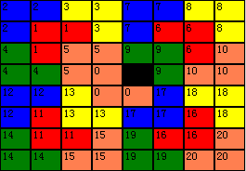

Slide 132
设T(k)是覆盖一个2^{k}×2^{k}棋盘所需时间，从算法的划分策略可知，T(k)满足如下递推式：
解此递推式可得T(k)=O(4^{k})。由于覆盖一个2^{k}×2^{k}棋盘所需的骨牌个数为(4^{k}-1)/3，所以，算法4.8是一个在渐进意义下的最优算法。

Slide 133
4.10 循环赛日程表
设有n=2^{k}个运动员要进行网球比赛。设计一个满足以下要求的比赛日程表：
每个选手必须与其它n-1个选手各赛一次
每个选手一天只能赛一次
循环赛一共进行n-1天
按此要求可将比赛日程表设计成有n行和n-1列的一个表。在表中第i行和第j列处填入第i个选手在第j天所遇到的选手。若将运动员的编号作为第1列，那么形成n*n的二维表。

Slide 134
设有8个运动员，共比赛7天，比赛日程表如下
运动员
编号
第1天
…… …… …… …… …… …… ……
第7天
1 | 2 | 3 | 4 | 5 | 6 | 7 | 8
2 | 1 | 4 | 3 | 6 | 5 | 8 | 7
3 | 4 | 1 | 2 | 7 | 8 | 5 | 6
4 | 3 | 2 | 1 | 8 | 7 | 6 | 5
5 | 6 | 7 | 8 | 1 | 2 | 3 | 4
6 | 5 | 8 | 7 | 2 | 1 | 4 | 3
7 | 8 | 5 | 6 | 3 | 4 | 1 | 2
8 | 7 | 6 | 5 | 4 | 3 | 2 | 1

Slide 135
循环赛日程表
按分治策略，可将所有选手分成二组。
n个选手的比赛日程表，可以通过为n/2个选手设计日程表来决定；
n/2个选手的比赛日程表，可以通过为n/4个选手设计日程表来决定；
…………；
直到为2个选手设计比赛日程表。这样比赛日程表的设计就变得很简单，这时只要让二个选手相互比赛即可。
假设运动员有8位，首先形成4组2个选手的比赛日程表。
1 | 2
2 | 1
3 | 4
4 | 3
5 | 6
6 | 5
7 | 8
8 | 7
表1
表2
表3
表4
说明：
1号选手在第一天与2号选手比赛，或称2号选手在第一天与1号选手比赛，是1场比赛，而不是2场比赛，在日程表中应描述为二行。

Slide 136
循环赛日程表
为2个选手的相互比赛设计了比赛日程表后，在此基础上为4个选手相互比赛设计比赛日程表。将表2抄至表1的右侧，将表1抄至表2的右侧；再将表4抄至表3的右侧，将表3抄至表4的右侧，这样就形成了2组4个选手的比赛日程表。
称为4人表的右上角
1 | 2
2 | 1
3 | 4
4 | 3
5 | 6
6 | 5
7 | 8
8 | 7
3 | 4
4 | 3
1 | 2
2 | 1
7 | 8
8 | 7
5 | 6
6 | 5
表5
称为4人表的右下角
表6

Slide 137
循环赛日程表
1 | 2
2 | 1
3 | 4
4 | 3
5 | 6
6 | 5
7 | 8
8 | 7
3 | 4
4 | 3
1 | 2
2 | 1
7 | 8
8 | 7
5 | 6
6 | 5
表5
表6
以水平方向观察表5。上半部分是 “表1左表2右” ，下半部分是“表2左表1右” 。由于表1中的运动员和表2中的运动员完全不同，所以拼接后在每一行中不可能存在二个相同号码，即拼接后不会产生一个运动员和另一个运动员比赛二次的情况。
类似以垂直方向观察表5。左半部分是“表1上表2下”，右半部分是“表2上表1下”。由于表1中的运动员和表2中的运动员完全不同，所以在每一列中不可能存在二个相同号码，即拼接后不会产生一个运动员在同一天和不同选手比赛二场或二场以上的情况。

Slide 138
循环赛日程表
类似基于4个选手比赛日程表为8个选手相互比赛设计比赛日程表。
1 | 2
2 | 1
3 | 4
4 | 3
5 | 6
6 | 5
7 | 8
8 | 7
称为8人表的右上角
3 | 4
4 | 3
1 | 2
2 | 1
7 | 8
8 | 7
5 | 6
6 | 5
5 | 6
6 | 5
7 | 8
8 | 7
1 | 2
2 | 1
3 | 4
4 | 3
7 | 8
8 | 7
5 | 6
6 | 5
3 | 4
4 | 3
1 | 2
2 | 1
称为8人表的右下角

Slide 139
循环赛日程表
输入：运动员人数n（n=2^{i}，i=log₂n）
输出：比赛日程表A[1..n,1..n]
1. for i←1 to n A[i,1]←i //设置运动员编号
2. k←2 //初值k=2，先处理2个运动员循环赛日程表。
3. while k≤n
4. v←0 //初值v=0，当k=2时先处理(1,2)。
5. while v≤n-k
6. for i←1 to k/2 //沿对角线处理右下角。
7. for j←1 to k/2
8. a[v+i+k/2,j+k/2]←a[v+i,j]
9. end for
10. end for
11. for i←k/2+1 to k //沿对角线处理右上角。
12. for j←1 to k/2
13. a[v+i-k/2,j+k/2]←a[v+i,j]
14. end for
15. end for
16. v←v+k //当k=2，则v的值为2,4,6，依次处理 (3,4),(5,6),(7,8)。
17. end while
18. k←k*2 //然后处理4、8、…、n=2^{k}个运动员的比赛日程表
19. end while

Slide 140
循环赛日程表
算法时间复杂性分析
由程序中的第3至第7句可知，程序含4重循环。尽管程序含4重循环，但在循环体中语句所做的工作是填表，并且表中的每个单元被填写且仅被填写一次。由于二维数组的规模为n²，所以算法的时间复杂性可用Θ(n²)来表示。
T(n) = T(n/2) + (n/2)×(n/2)
思考题：
“循环赛日程表” 递归算法的实现。N若不是2^{k}呢？
复制的时间

Slide 141
算法——循环赛日程表
void GameTable(int k, int a[ ][ ])
{
// n=2^{k}(k≥1)个选手参加比赛，
//二维数组a表示日程安排，数组下标从1开始
n=2; //k=0，2个选手比赛日程可直接求得
//求解2个选手比赛日程，得到左上角元素
a[1][1]=1; a[1][2]=2;
a[2][1]=2; a[2][2]=1;
for (t=1; t<k; t++)
//迭代处理，依次处理2², …, 2^{k}个选手比赛日程
{
C++描述

Slide 142
temp=n; n=n*2;
//填左下角元素
for (i=temp+1; i<=n; i++ )
for (j=1; j<=temp; j++)
a[i][j]=a[i-temp][j]+temp;
//左下角元素和左上角元素的对应关系
//填右上角元素
for (i=1; i<=temp; i++)
for (j=temp+1; j<=n; j++)
a[i][j]=a[i+temp][(j+temp)% n];
//填右下角元素
for (i=temp+1; i<=n; i++)
for (j=temp+1; j<=n; j++)
a[i][j]=a[i-temp][j-temp];
}
}

Slide 143

分析算法的时间性能，迭代处理的循环体内部有3个循环语句，每个循环语句都是一个嵌套的for循环，且他们的执行次数相同，基本语句是最内层循环体的赋值语句，即填写比赛日程表中的元素。基本语句的执行次数是：
所以，算法的其时间复杂性为O(4^{k})。

Slide 144
4.11 The Voronoi diagram problem
给定平面中N个点，对于每个点Pi，平面中距离Pi点比距离其它点更近的点的区域是什么? 即区域内的任意一点(x,y)，距Pi比距离平面中的其它点都近。
首先从最简单的情况入手，对于平面中两个点A、B，距离A点比距离B点近的点的区域是由A、B的垂直平分线确定的包含A的那半个平面。
如果点集由N个点组成，距离Pi比距离其它点更近的点的区域是包含Pi的那N-1个半平面的交集。这N-1个半平面是由Pi点与其它点的垂直平分线确定的。
又叫泰森多边形或Dirichlet图。Voronoi图是Delaunay图的偶图
任何一个Delaunay三角形的外接圆的内部不能包含其他任何点（空圆特性）[Delaunay 1934]。
Lawson[1972]提出了最大化最小角原则
Notes:
Voronoi图，又叫泰森多边形或Dirichlet图，它是由一组由连接两邻点直线的垂直平分线组成的连续多边形组成。N个在平面上有区别的点，按照最邻近原则划分平面；每个点与它的最近邻区域相关联。Delaunay三角形是由与相邻Voronoi多边形共享一条边的相关点连接而成的三角形。Delaunay三角形的外接圆圆心是与三角形相关的Voronoi多边形的一个顶点。 Voronoi三角形是Delaunay图的偶图；
目录
Delaunay三角网的特征Delaunay三角形的基本准则Delaunay三角形网的通用算法－逐点插入算法
编辑本段Delaunay三角网的特征
对于给定的初始点集P，有多种三角网剖分方式，其中Delaunay三角网具有以下特征：
1、Delaunay三角网是唯一的；
2、三角网的外边界构成了点集P的凸多边形“外壳”；
3、没有任何点在三角形的外接圆内部，反之，如果一个三角网满足此条件，那么它就是Delaunay三角网。
4、如果将三角网中的每个三角形的最小角进行升序排列，则Delaunay三角网的排列得到的数值最大，从这个意义上讲，Delaunay三角网是“最接近于规则化的“的三角网。
Delaunay三角形网的特征又可以表达为以下特性：
1、在Delaunay三角形网中任一三角形的外接圆范围内不会有其它点存在并与其通视，即空圆特性；
2、在构网时，总是选择最邻近的点形成三角形并且不与约束线段相交；
3、形成的三角形网总是具有最优的形状特征，任意两个相邻三角形形成的凸四边形的对角线如果可以互换的话，那么两个三角形6个内角中最小的角度不会变大；
4、不论从区域何处开始构网，最终都将得到一致的结果，即构网具有唯一性。
编辑本段Delaunay三角形的基本准则
任何一个Delaunay三角形的外接圆的内部不能包含其他任何点[Delaunay 1934]。Lawson[1972]提出了最大化最小角原则，每两个相邻的三角形构成凸四边形的对角线，在相互交换后，六个内角的最小角不再增大。Lawson[1977提出了一个局部优化过程（LOP, local Optimization Procedure）方法。
编辑本段Delaunay三角形网的通用算法－逐点插入算法
基于散点建立数字地面模型，常采用在d维的欧几里得空间Ed中构造Delaunay三角形网的通用算法—逐点插入算法，具体算法过程如下：
1、遍历所有散点，求出点集的包容盒，得到作为点集凸壳的初始三角形并放入三角形链表。
2、将点集中的散点依次插入，在三角形链表中找出其外接圆包含插入点的三角形（称为该点的影响三角形），删除影响三角形的公共边，将插入点同影响三角形的全部顶点连接起来，从而完成一个点在Delaunay三角形链表中的插入。
3、根据优化准则对局部新形成的三角形进行优化（如互换对角线等）。将形成的三角形放入Delaunay三角形链表。
4、循环执行上述第2步，直到所有散点插入完毕。
上述基于散点的构网算法理论严密、唯一性好，网格满足空圆特性，较为理想。由其逐点插入的构网过程可知，在完成构网后，增加新点时，无需对所有的点进行重新构网，只需对新点的影响三角形范围进行局部联网，且局部联网的方法简单易行。同样，点的删除、移动也可快速动态地进行。但在实际应用当中，这种构网算法不易引入地面的地性线和特征线，当点集较大时构网速度也较慢，如果点集范围是非凸区域或者存在内环，则会产生非法三角形。
为了克服基于散点构网算法的上述缺点，特别是为了提高算法效率，可以对网格中三角形的空圆特性稍加放松，亦即采用基于边的构网方法，其算法简述如下：
1、根据已有的地性线和特征线，形成控制边链表。
2、以控制边链表中一线段为基边，从点集中找出同该基边两端点距离和最小的点，以该点为顶点，以该基边为边，向外扩展一个三角形（仅满足空椭圆特性）并放入三角形链表。
3、按照上述第2步，对控制边链表所有的线段进行循环，分别向外扩展。
4、依次将新形成的三角形的边作为基边，形成新的控制边链表，按照上述第2步，对控制边链表所有的线段进行循环，再次向外扩展，直到所有三角形不能再向外扩展为止

Slide 145
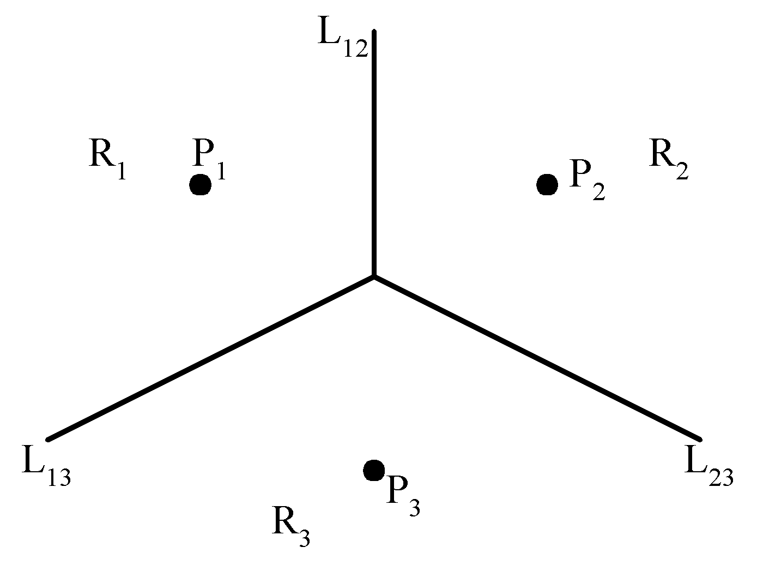
The Voronoi diagram problem
e.g. The Voronoi diagram for three points
Each L_{ij} is the perpendicular bisector of line segment . The intersection of three L_{ij}‘s is the circumcenter (外心) of triangle P₁P₂P₃.
Notes:
Voronoi图，又叫泰森多边形或Dirichlet图，它是由一组由连接两邻点直线的垂直平分线组成的连续多边形组成。N个在平面上有区别的点，按照最邻近原则划分平面；每个点与它的最近邻区域相关联。Delaunay三角形是由与相邻Voronoi多边形共享一条边的相关点连接而成的三角形。Delaunay三角形的外接圆圆心是与三角形相关的Voronoi多边形的一个顶点。 Voronoi三角形是Delaunay图的偶图；
目录
Delaunay三角网的特征Delaunay三角形的基本准则Delaunay三角形网的通用算法－逐点插入算法
编辑本段Delaunay三角网的特征
对于给定的初始点集P，有多种三角网剖分方式，其中Delaunay三角网具有以下特征：
1、Delaunay三角网是唯一的；
2、三角网的外边界构成了点集P的凸多边形“外壳”；
3、没有任何点在三角形的外接圆内部，反之，如果一个三角网满足此条件，那么它就是Delaunay三角网。
4、如果将三角网中的每个三角形的最小角进行升序排列，则Delaunay三角网的排列得到的数值最大，从这个意义上讲，Delaunay三角网是“最接近于规则化的“的三角网。
Delaunay三角形网的特征又可以表达为以下特性：
1、在Delaunay三角形网中任一三角形的外接圆范围内不会有其它点存在并与其通视，即空圆特性；
2、在构网时，总是选择最邻近的点形成三角形并且不与约束线段相交；
3、形成的三角形网总是具有最优的形状特征，任意两个相邻三角形形成的凸四边形的对角线如果可以互换的话，那么两个三角形6个内角中最小的角度不会变大；
4、不论从区域何处开始构网，最终都将得到一致的结果，即构网具有唯一性。
编辑本段Delaunay三角形的基本准则
任何一个Delaunay三角形的外接圆的内部不能包含其他任何点[Delaunay 1934]。Lawson[1972]提出了最大化最小角原则，每两个相邻的三角形构成凸四边形的对角线，在相互交换后，六个内角的最小角不再增大。Lawson[1977提出了一个局部优化过程（LOP, local Optimization Procedure）方法。
编辑本段Delaunay三角形网的通用算法－逐点插入算法
基于散点建立数字地面模型，常采用在d维的欧几里得空间Ed中构造Delaunay三角形网的通用算法—逐点插入算法，具体算法过程如下：
1、遍历所有散点，求出点集的包容盒，得到作为点集凸壳的初始三角形并放入三角形链表。
2、将点集中的散点依次插入，在三角形链表中找出其外接圆包含插入点的三角形（称为该点的影响三角形），删除影响三角形的公共边，将插入点同影响三角形的全部顶点连接起来，从而完成一个点在Delaunay三角形链表中的插入。
3、根据优化准则对局部新形成的三角形进行优化（如互换对角线等）。将形成的三角形放入Delaunay三角形链表。
4、循环执行上述第2步，直到所有散点插入完毕。
上述基于散点的构网算法理论严密、唯一性好，网格满足空圆特性，较为理想。由其逐点插入的构网过程可知，在完成构网后，增加新点时，无需对所有的点进行重新构网，只需对新点的影响三角形范围进行局部联网，且局部联网的方法简单易行。同样，点的删除、移动也可快速动态地进行。但在实际应用当中，这种构网算法不易引入地面的地性线和特征线，当点集较大时构网速度也较慢，如果点集范围是非凸区域或者存在内环，则会产生非法三角形。
为了克服基于散点构网算法的上述缺点，特别是为了提高算法效率，可以对网格中三角形的空圆特性稍加放松，亦即采用基于边的构网方法，其算法简述如下：
1、根据已有的地性线和特征线，形成控制边链表。
2、以控制边链表中一线段为基边，从点集中找出同该基边两端点距离和最小的点，以该点为顶点，以该基边为边，向外扩展一个三角形（仅满足空椭圆特性）并放入三角形链表。
3、按照上述第2步，对控制边链表所有的线段进行循环，分别向外扩展。
4、依次将新形成的三角形的边作为基边，形成新的控制边链表，按照上述第2步，对控制边链表所有的线段进行循环，再次向外扩展，直到所有三角形不能再向外扩展为止

Slide 146
Voronoi图的定义
直线L
设P₁,P₂是平面上的两个点，L是的它们的中垂线，L将平面分成两部分半平面L₁和半平面L₂，在L₁内的点P具有特性|PP₁|<|PP₂|，即位于L_{l}内的点比平面中其他点更接近点P₁ ，我们记半平面H(P₁, P₂)= L₁ ，同理半平面H(P₂, P₁)= L₂ 。
平面L₁
平面L₂
P₁
P₂
P

Slide 147
Voronoi图的定义
对于平面上n个点的点集S,定义V(P_{i})=∩H(P_{i},P_{j})，即V(P_{i})表示比其他点更接近P_{i}的点的轨迹是n-1个半平面的交集，它是一个不多于n-1条边的凸多边形区域，称为关联于P_{i}的Voronoi多边形或关联于P_{i}的Voronoi多边形域。
P_{j}
位于多边形V(p_{i})内的任意一个点P满足|PP_{i}|<|PP_{j}|(i<>j)
p
p_{i}
n=6时的一种V(p_{i})

Slide 148
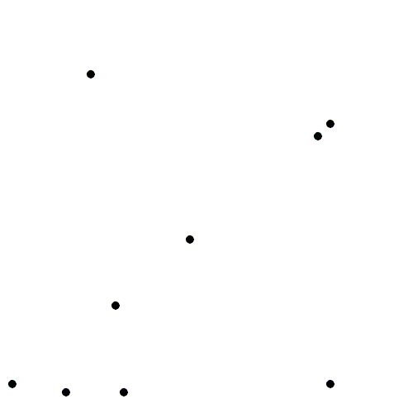
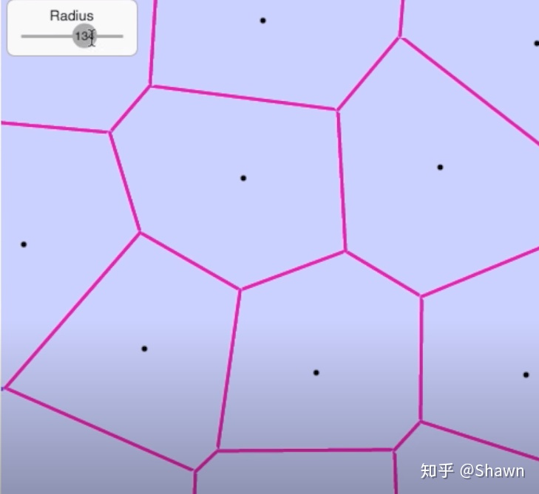
Voronoi图的定义
对于S中的每个点都可以 作一个Voronoi多边形，这样n个Voronoi多边形组成的图称为Voronoi图，记为Vor(S)。
n=6时的Vor(S)

Slide 149
Voronoi图的构造
编写麻烦
传统的构造方法
难于理解
编写容易
分治法构造Delaunay三角剖分法
易于理解
O(N log N)

Slide 150
Voronoi图的构造
用分治法构造角最优三角剖分，首先要对点集依照X坐标排序。如果点集内点的个数小于等于3，那么可以直接构造，否则将点集拆分成为两个含点数目近似的点集进行构造，最后合并这两个点集。
点集内含点个数为3的情况
点集内含点个数为2的情况
如何合并呢？

Slide 151
合并两个子点集的角最优三角剖分
首先，求解两个点集的凸包的最下方的正切线,并连接两端点。
然后找到L₁₄与A₁(或A₄)相关联的边中，中垂线与L₁₄有交点的边，如果有多个边，那么选择交点Y坐标最小的点所关联边。
如图所示，选择的边为A₁A₂，那么连接A₂A₄，并且删除与A₂A₄相交的边。设A₂A₄为新产生的正切线。
接下来，如图所示，A₁A₄为两个凸包的正切线，求出它们的中垂线L₁₄。
A₃
相交的边
A₅
直线L₁₄
A₂
新确定的正切线
A₆
A₁
A₄

Slide 152
Voronoi图的构造
重复上述步骤，我们就能合并两个点集的角最优三角剖分。
这样，依照该方案，我们就能构造出来点集S的角最优三角剖分了。
这个三角剖分的直线对偶图就是点集S的Voronoi图。
A3
A5
A2
A6
A1
A4

Slide 153
Voronoi图的构造
O(NlogN)
T(N)=2T(N/2)+O(N)
求解含有n个点的点集的角最优三角剖分
求解含有n/2个点的点集的角最优三角剖分
合并两个点集的角最优三角剖分

Slide 154
Voronoi图与平面MST问题
例 平面MST问题
给定平面上的点集S，求出连接S中所有点的最小长度的树，并且要求最小生成树的结点恰好是S中的点。

Slide 155
Voronoi图与平面MST问题
传统的求最小生成树的方法是贪心法，要是纯粹使用贪心法求平面最小生成树，我们所作的程序时间复杂度至少为：O(n²)
有没有更快的方法呢？
当然有!用Voronoi图。

Slide 156
Voronoi图与平面MST问题
实际上Voronoi图的对偶图是点集的角最优三角剖分，我们把这个三角剖分中的边组成的集合叫做DT(S).
那么，有这样一个定理：
最小生成树MST是角最优三角剖分DT(S)的一个子集
时间复杂度是O(n log n)

Slide 157
关于定理的证明
也就是说，具有直径ab的圆周上或圆内必有S中的点，假设c在该圆周上或者圆内，那么|ac|<|ab|，并且|bc|<|ab|。那么，我们删除ab，把树T分成T_{a}和T_{b}两部分，不妨假设c∈T_{a}，那么我们添加边cb，可以合并成新的树，并且树的总长度小于T，因此包含ab的树长度不可能是最小的。所以必然MST∈DT(S)
证明：
假设存在一条边ab∈DT(S)，则由三角剖分的定理可以知道过a,b有一个空圆。因此如果ab不属于DT(S)，那么过a,b的圆不可能是空的。
T_{a}
T_{b}
c
a
b
Notes:
Delaunay边：假设E中的一条边e（两个端点为a,b），e若满足下列条件，则称之为Delaunay边：存在一个圆经过a,b两点，圆内(注意是圆内，圆上最多三点共圆)不含点集V中任何其他的点，这一特性又称空圆特性。

Slide 158
Voronoi图与平面MST问题
根据这个条件，可以得到一个新的方案，构造角最优三角剖分，然后计算最小生成树，总的时间复杂度是O(n log n)。

Slide 159
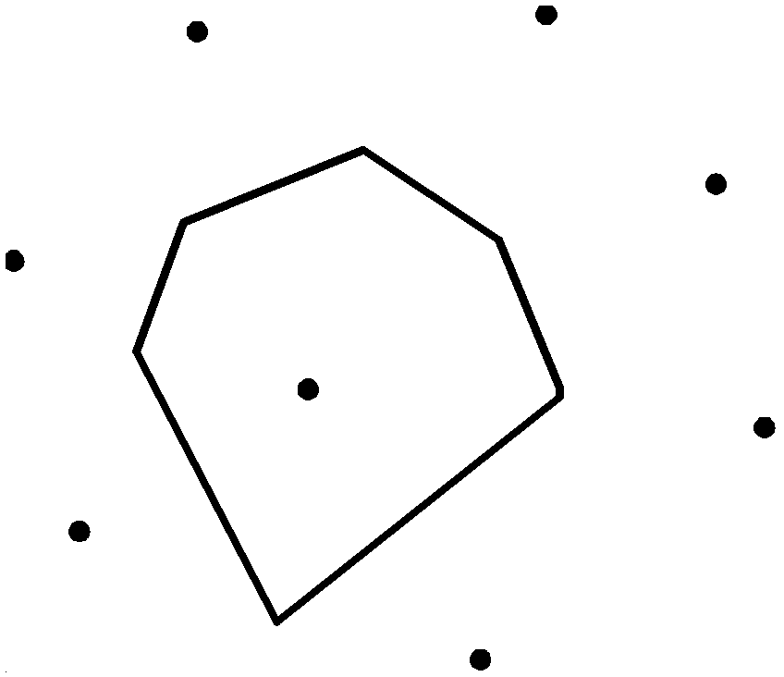
Definition of Voronoi diagrams
Def : Given two points P_{i}, P_{j} ∈ S, let H(P_{i},P_{j}) denote the half plane containing P_{i}. The Voronoi polygon associated with P_{i} is defined as

Slide 160
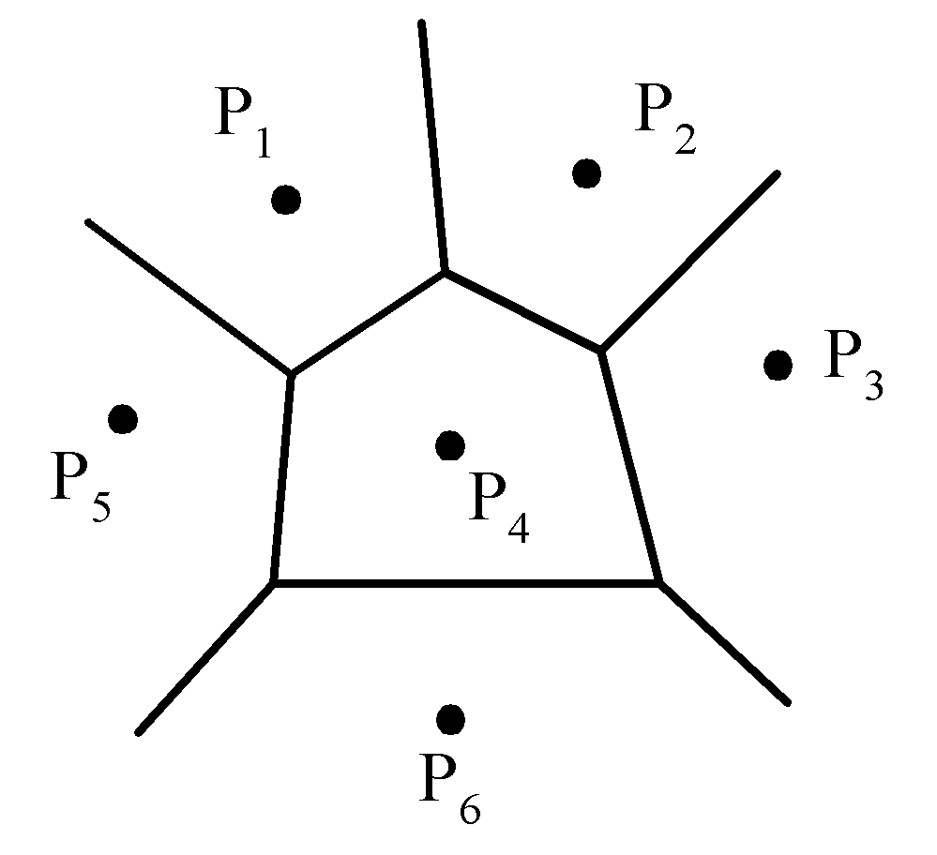
Given a set of n points, the Voronoi diagram consists of all the Voronoi polygons of these points.
The vertices of the Voronoi diagram are called Voronoi points and its segments are called Voronoi edges.

Slide 161
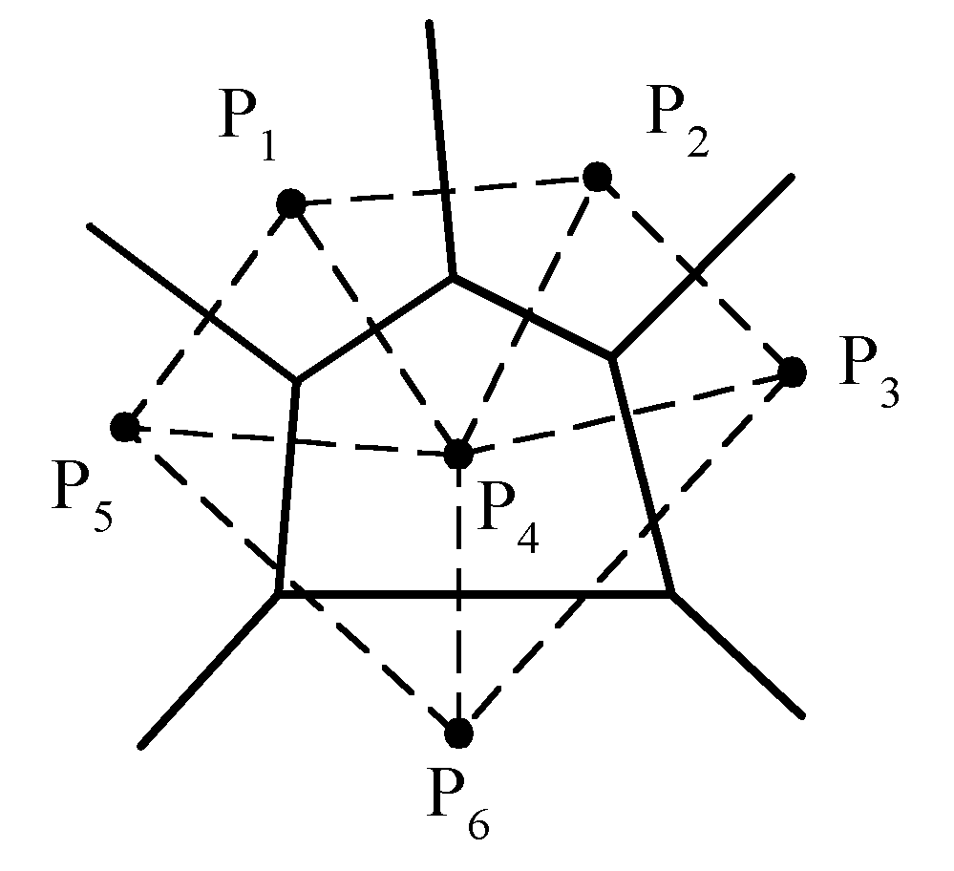
Delaunay triangulation

Slide 162
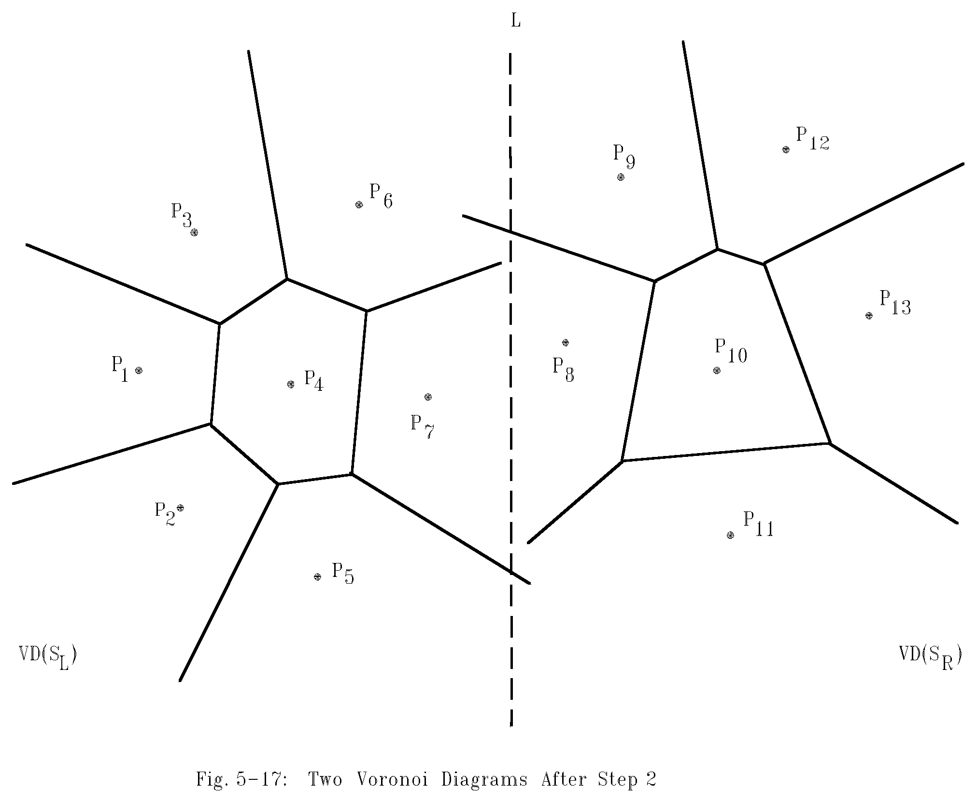
Example for constructing Voronoi diagrams
Divide the points into two parts.

Slide 163
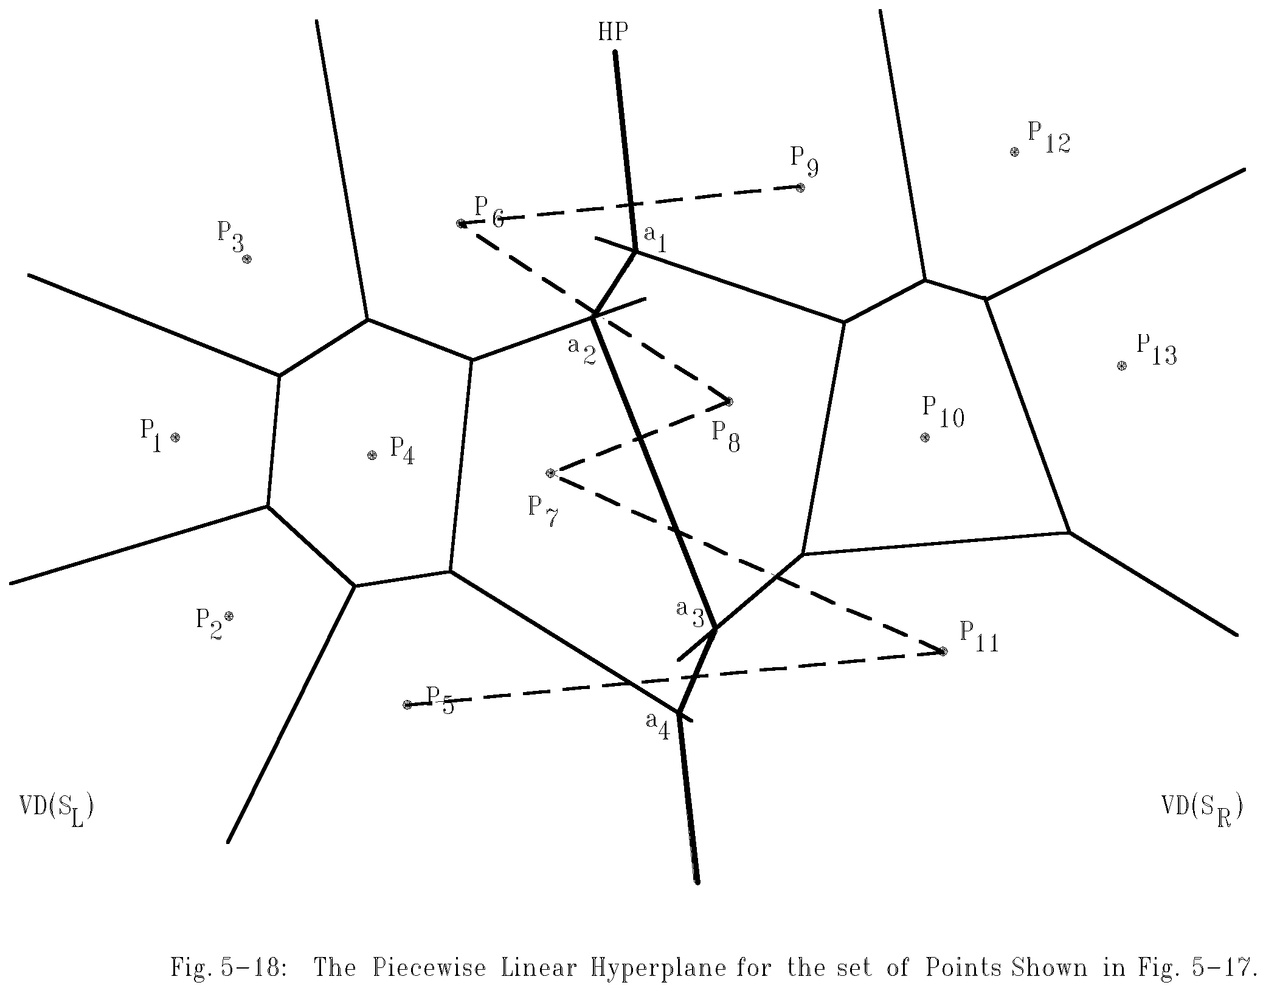
Merging two Voronoi diagrams
Merging along the piecewise linear hyperplane

Slide 164
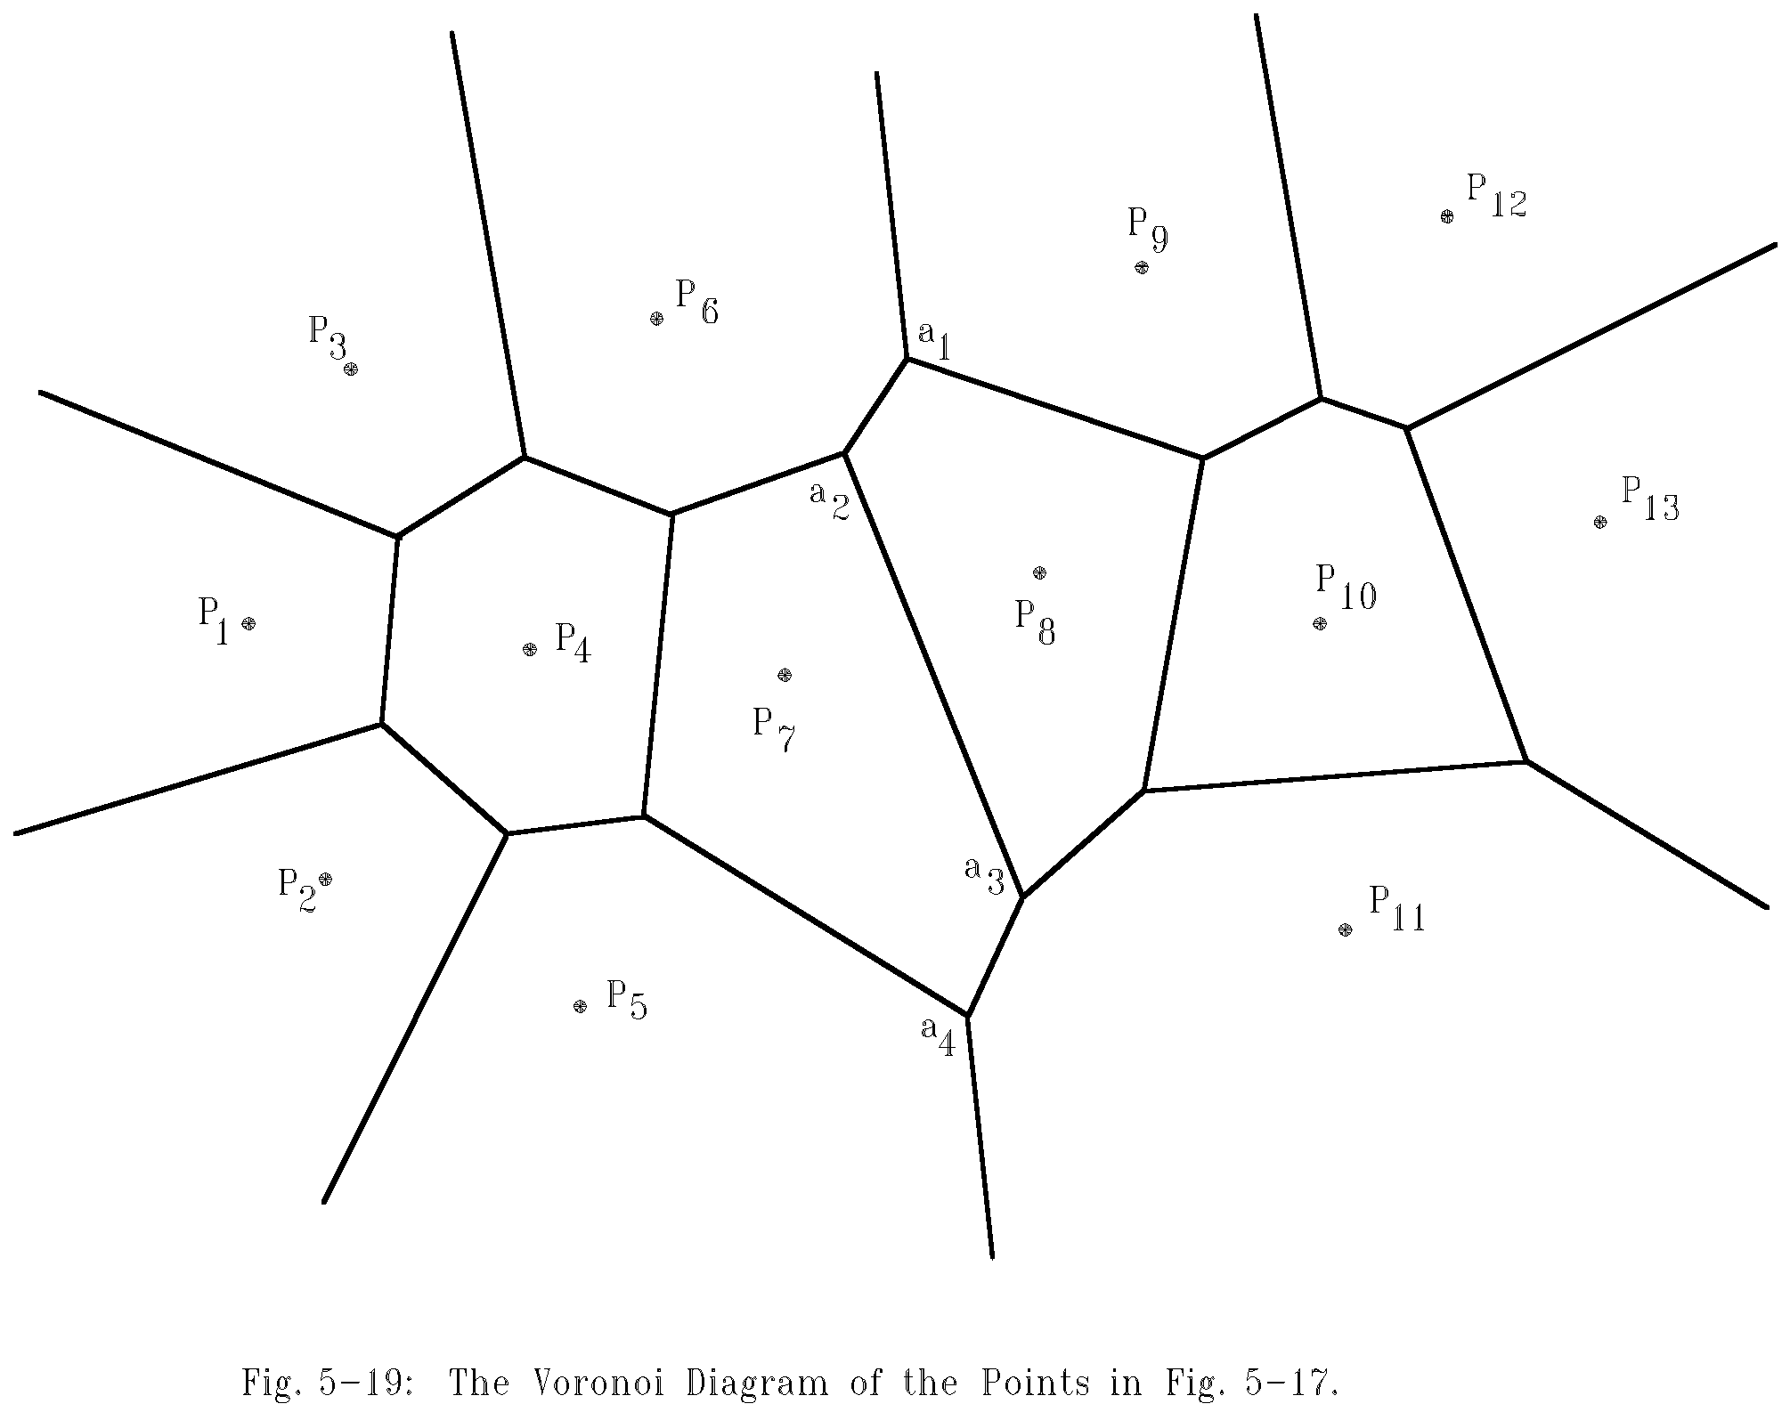
The final Voronoi diagram
After merging

Slide 165
Divide-and-conquer for Voronoi diagram
Input: A set S of n planar points.
Output: The Voronoi diagram of S.
Step 1: If S contains only one point, return.
Step 2: Find a median line L perpendicular to the X-axis which divides S into S_{L} and S_{R}, with equal sizes.

Slide 166
Step 3: Construct Voronoi diagrams of S_{L} and S_{R} recursively. Denote these Voronoi diagrams by VD(S_{L}) and VD(S_{R}).
Step 4: Construct a dividing piece-wise linear hyperplane HP which is the locus of points simultaneously closest to a point in S_{L} and a point in S_{R}. Discard all segments of VD(S_{L}) which lie to the right of HP and all segments of VD(S_{R}) that lie to the left of HP. The resulting graph is the Voronoi diagram of S.
(See details on the next page.)

Slide 167
Mergeing Two Voronoi Diagrams into One Voronoi Diagram
Input: (a) S_{L} and S_{R} where S_{L} and S_{R} are divided by a perpendicular line L.
(b) VD(S_{L} ) and VD(S_{R} ).
Output: VD(S) where S = S_{L} ∩S_{R}
Step 1: Find the convex hulls of S_{L} and S_{R}, denoted as Hull(S_{L}) and Hull(S_{R}), respectively. (A special algorithm for finding a convex hull in this case will by given later.)

Slide 168
Step 2: Find segments and which join HULL(S_{L} ) and HULL(S_{R} ) into a convex hull (P_{a} and P_{c} belong to S_{L} and P_{b} and P_{d} belong to S_{R}) Assume that lies above . Let x = a, y = b, SG= and HP = ∅ .
Step 3: Find the perpendicular bisector of SG. Denote it by BS. Let HP = HP∪{BS}. If SG = , go to Step 5; otherwise, go to Step 4.

Slide 169
Step 4: The ray from VD(S_{L} ) and VD(S_{R}) which BS first intersects with must be a perpendicular bisector of either or for some z. If this ray is the perpendicular bisector of , then let SG = ; otherwise, let SG = . Go to Step 3.
Step 5: Discard the edges of VD(S_{L}) which extend to the right of HP and discard the edges of VD(S_{R}) which extend to the left of HP. The resulting graph is the Voronoi diagram of S = S_{L}∪S_{R}.

Slide 170
Properties of Voronoi Diagrams
Def : Given a point P and a set S of points, the distance between P and S is the distance between P and P_{i} which is the nearest neighbor of P in S.
The HP obtained from the above algorithm is the locus of points which keep equal distances to S_{L} and S_{R} .
The HP is monotonic in y.

Slide 171
# of Voronoi edges
# of edges of a Voronoi diagram ≤ 3n - 6, where n is # of points.
Reasoning:
# of edges of a planar graph with n vertices ≤ 3n - 6.
A Delaunay triangulation is a planar graph.
Edges in Delaunay triangulation
edges in Voronoi diagram.

Slide 172
# of Voronoi vertices
# of Voronoi vertices ≤ 2n - 4.
Reasoning:
Let F, E and V denote # of face, edges and vertices in a planar graph.
Euler’s relation: F = E - V + 2.
In a Delaunay triangulation,
triangle Voronoi vertex
V = n, E ≤ 3n – 6
⇒ F = E - V + 2 ≤ 3n - 6 - n + 2 = 2n - 4.

Slide 173
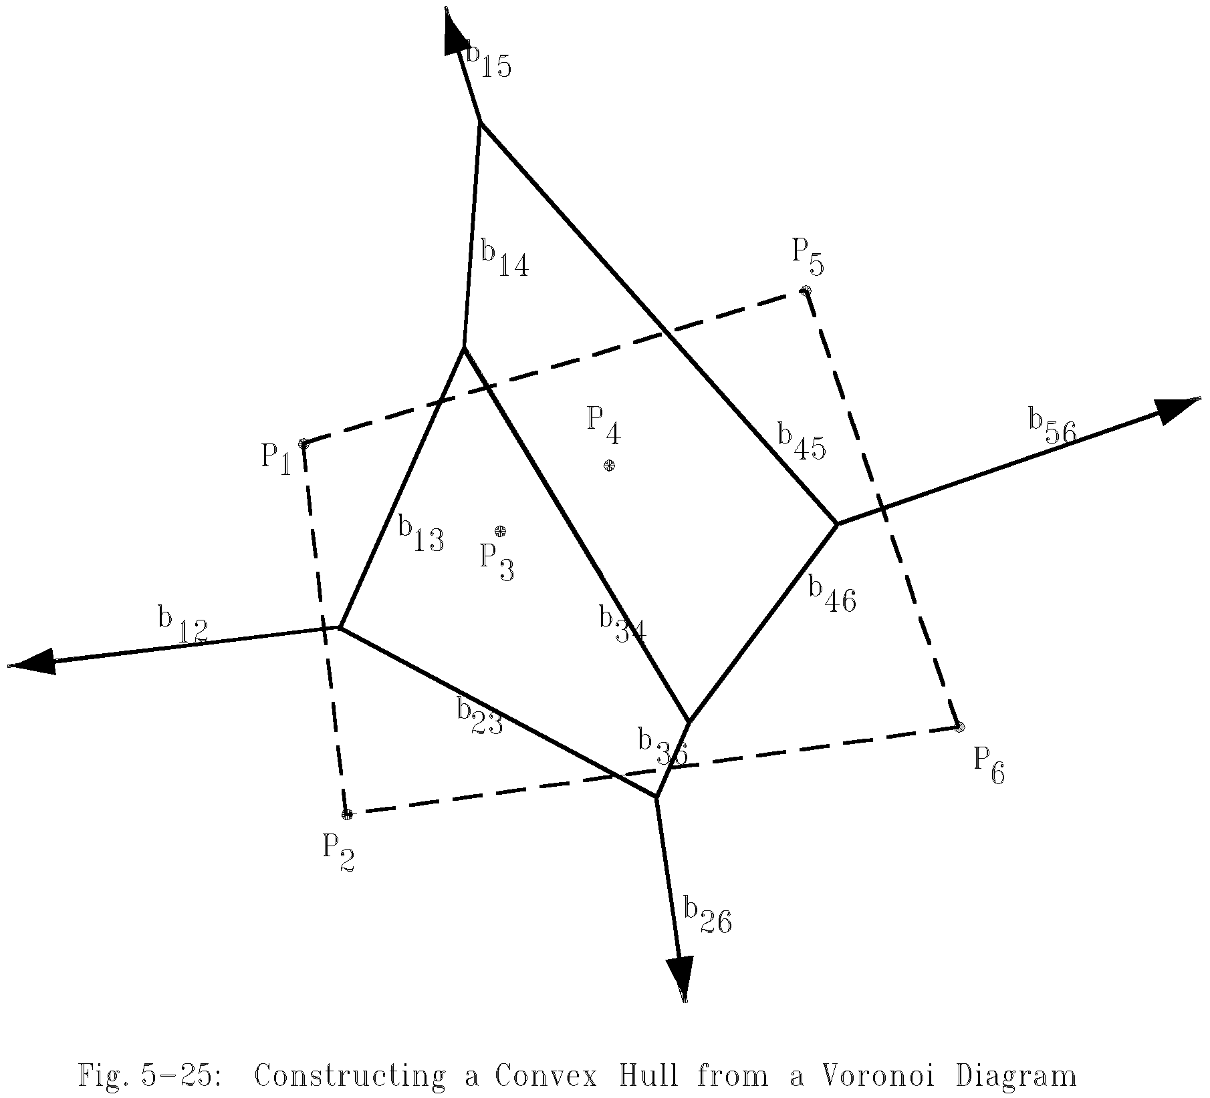
Construct a convex hull from a Voronoi diagram
After a Voronoi diagram is constructed, a convex hull can by found in O(n) time.

Slide 174
Construct a convex hull from a Voronoi diagram
Step 1: Find an infinite ray by examining all Voronoi edges.
Step 2: Let P_{i} be the point to the left of the infinite ray. P_{i} is a convex hull vertex. Examine the Voronoi polygon of P_{i} to find the next infinite ray.
Step 3: Repeat Step 2 until we return to the starting ray.

Slide 175
Time complexity
Time complexity for merging 2 Voronoi diagrams:
Total: O(n)
Step 1: O(n)
Step 2: O(n)
Step 3 ~ Step 5: O(n)
(at most 3n - 6 edges in VD(S_{L}) and VD(S_{R}) and at most n segments in HP)
Time complexity for constructing a Voronoi diagram: O(n log n)
because T(n) = 2T(n/2) + O(n)=O(n log n)

Slide 176
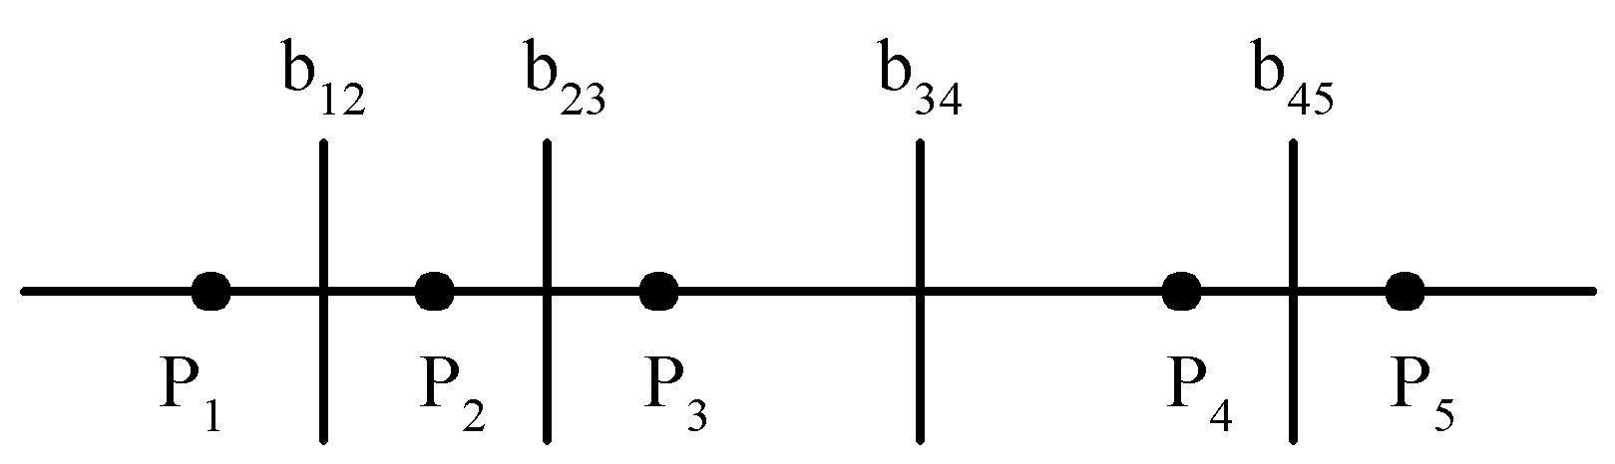
Lower bound
The lower bound of the Voronoi diagram problem is Ω(n log n).
sorting ∝ Voronoi diagram problem
The Voronoi diagram for a set of points on a straight line

Slide 177
Applications of Voronoi diagrams
The Euclidean nearest neighbor searching problem.
The Euclidean all nearest neighbor problem.

Slide 178
4.12 Fast Fourier Transform
Applications:
Optics, acoustics, quantum physics, telecommunications, radar, control systems, signal processing, speech recognition, data compression, image processing, seismology, mass spectrometry…
Digital media. [DVD, JPEG, MP3, H.264]
Medical diagnostics. [MRI, CT, PET scans, ultrasound]
Numerical solutions to Poisson's equation.
Shor's quantum factoring algorithm

Slide 179
The FFT is one of the truly great computational developments of [the 20th] century. It has changed the face of science and engineering so much that it is not an exaggeration to say that life as we know it would be very different without the FFT.
-- Charles van Loan

Slide 180
Fast Fourier transform (FFT)
Fourier transform
Inverse Fourier transform
Discrete Fourier transform(DFT)
Given a₀, a₁, …, a_{n-1} , compute

Slide 181
DFT and waveform(1)
Any periodic waveform can be decomposed into the linear sum of sinusoid functions (sine or cosine).

Slide 182
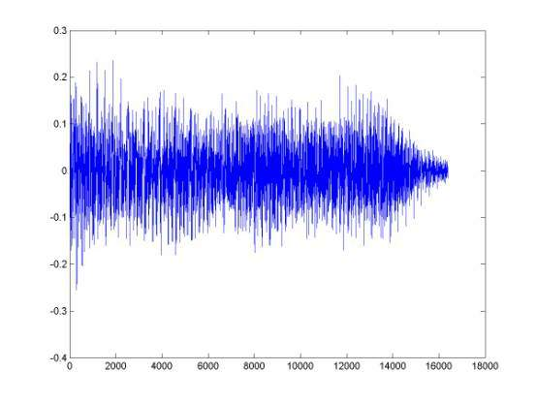
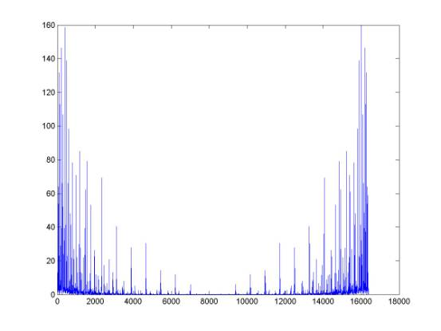
DFT and waveform (2)
The waveform of a music signal of 1 second
The frequency spectrum of the music signal with DFT

Slide 183
An application of the FFT ⎯ polynomial multiplication
Polynomial multiplication:
The straightforward product requires O(n²) time.
DFT notations:

Slide 184
Fast polynomial multiplication
Step 1: Let N be the smallest integer that N=2^{q} and N≥2n-1.
Step 2: Compute FFT of
Step 3: Compute FFT of
Step 4:
Step 5:
Time complexity: O(NlogN)=O(nlogn), N<4n.

Slide 185
FFT algorithm
Inverse DFT:
DFT can be computed in O(n²) time by a straightforward method.
DFT can be solved by the divide-and-conquer strategy (FFT) in O(nlogn) time.

Slide 186
FFT algorithm when n=4
n=4, w=e^{i2π/4} , w⁴=1, w²=-1
b₀=a₀+a₁+a₂+a₃
b₁=a₀+a₁w+a₂w²+a₃w³
b₂=a₀+a₁w²+a₂w⁴+a₃w⁶
b₃=a₀+a₁w³+a₂w⁶+a₃w⁹
another form:
b₀ =(a₀+a₂)+(a₁+a₃)
b₂ =(a₀+a₂w⁴)+(a₁w²+a₃w⁶) =(a₀+a₂)-(a₁+a₃)
When we calculate b₀, we shall calculate (a₀+a₂) and (a₁+a₃). Later, b₂ van be easily calculated.
Similarly,
b₁ =(a₀+ a₂w²)+(a₁w+a₃w³) =(a₀-a₂)+w(a₁-a₃)
b₃ =(a₀+a₂w⁶)+(a₁w³+a₃w⁹) =(a₀-a₂)-w(a₁-a₃).

Slide 187
FFT algorithm when n=8
n=8, w=e^{i2π/8}, w⁸=1, w⁴=-1
b₀=a₀+a₁+a₂+a₃+a₄+a₅+a₆+a₇
b₁=a₀+a₁w+a₂w²+a₃w³+a₄w⁴+a₅w⁵+a₆w⁶+a₇w⁷
b₂=a₀+a₁w²+a₂w⁴+a₃w⁶+a₄w⁸+a₅w¹⁰+a₆w¹²+a₇w¹⁴
b₃=a₀+a₁w³+a₂w⁶+a₃w⁹+a₄w¹²+a₅w¹⁵+a₆w¹⁸+a₇w²¹
b₄=a₀+a₁w⁴+a₂w⁸+a₃w¹²+a₄w¹⁶+a₅w²⁰+a₆w²⁴+a₇w²⁸
b₅=a₀+a₁w⁵+a₂w¹⁰+a₃w¹⁵+a₄w²⁰+a₅w²⁵+a₆w³⁰+a₇w³⁵
b₆=a₀+a₁w⁶+a₂w¹²+a₃w¹⁸+a₄w²⁴+a₅w³⁰+a₆w³⁶+a₇w⁴²
b₇=a₀+a₁w⁷+a₂w¹⁴+a₃w²¹+a₄w²⁸+a₅w³⁵+a₆w⁴²+a₇w⁴⁹

Slide 188
After reordering, we have
b₀=(a₀+a₂+a₄+a₆)+(a₁+a₃+a₅+a₇)
b₁=(a₀+a₂w²+a₄w⁴+a₆w⁶)+ w(a₁+a₃w²+a₅w⁴+a₇w⁶)
b₂=(a₀+a₂w⁴+a₄w⁸+a₆w¹²)+ w²(a₁+a₃w⁴+a₅w⁸+a₇w¹²)
b₃=(a₀+a₂w⁶+a₄w¹²+a₆w¹⁸)+ w³(a₁+a₃w⁶+a₅w¹²+a₇w¹⁸)
b₄=(a₀+a₂+a₄+a₆)-(a₁+a₃+a₅+a₇)
b₅=(a₀+a₂w²+a₄w⁴+a₆w⁶)-w(a₁+a₃w²+a₅w⁴+a₇w⁶)
b₆=(a₀+a₂w⁴+a₄w⁸+a₆w¹²)-w²(a₁+a₃w⁴+a₅w⁸+a₇w¹²)
b₇=(a₀+a₂w⁶+a₄w¹²+a₆w¹⁸)-w³(a₁+a₃w⁶+a₅w¹²+a₇w¹⁸)
Rewrite as
b₀=c₀+d₀ b₄=c₀-d₀=c₀+w⁴d₀
b₁=c₁+wd₁ b₅=c₁-wd₁=c₁+w⁵d₁
b₂=c₂+w²d₂ b₆=c₂-w²d₂=c₂+w⁶d₂
b₃=c₃+w³d₃ b₇=c₃-w³d₃=c₃+w⁷d₃

Slide 189
c₀=a₀+a₂+a₄+a₆
c₁=a₀+a₂w²+a₄w⁴+a₆w⁶
c₂=a₀+a₂w⁴+a₄w⁸+a₆w¹²
c₃=a₀+a₂w⁶+a₄w¹²+a₆w¹⁸
Let x=w²=e^{i2π/4}
c₀=a₀+a₂+a₄+a₆
c₁=a₀+a₂x+a₄x²+a₆x³
c₂=a₀+a₂x²+a₄x⁴+a₆x⁶
c₃=a₀+a₂x³+a₄x⁶+a₆x⁹
Thus, {c₀,c₁,c₂,c₃} is FFT of {a₀,a₂,a₄,a₆}.
Similarly, {d₀,d₁,d₂,d₃} is FFT of {a₁,a₃,a₅,a₇}.

Slide 190
General FFT
In general, let w=e^{i2π/n} (assume n is even.)
w^{n}=1, w^{n/2}=-1
b_{j} =a₀+a₁w^{j}+a₂w^{2j}+…+a_{n-1}w^{(n-1)j},
={a₀+a₂w^{2j}+a₄w^{4j}+…+a_{n-2}w^{(n-2)j}}+
w^{j}{a₁+a₃w^{2j}+a₅w^{4j}+…+a_{n-1}w^{(n-2)j}}
=c_{j}+w^{j}d_{j}
b_{j+n/2}=a₀+a₁w^{j+n/2}+a₂w^{2j+n}+a₃w^{3j+3n/2}+…
+a_{n-1}w^{(n-1)j+n(n-1)/2}
=a₀-a₁w^{j}+a₂w^{2j}-a₃w^{3j}+…+a_{n-2}w^{(n-2)j}-a_{n-1}w^{(n-1)j}
=c_{j}-w^{j}d_{j}
=c_{j}+w^{j+n/2}d_{j}

Slide 191
Divide-and-conquer (FFT)
Input: a₀, a₁, …, a_{n-1}, n = 2^{k}
Output: b_{j}, j=0, 1, 2, …, n-1
where
Step 1: If n=2, compute
b₀ = a₀ + a₁,
b₁ = a₀ - a₁, and return.
Step 2: Recursively find the Fourier transform of {a₀, a₂, a₄,…, a_{n-2}} and {a₁, a₃, a₅,…,a_{n-1}}, whose results are denoted as {c₀, c₁, c₂,…, c_{n/2-1}} and {d₀, d₁, d₂,…, d_{n/2-1}}.

Slide 192
Step 3: Compute b_{j}:
b_{j} = c_{j} + w^{j}d_{j} for 0 ≤ j ≤ n/2 - 1
b_{j+n/2} = c_{j} - w^{j}d_{j} for 0 ≤ j ≤ n/2 - 1.
Time complexity:
T(n) = 2T(n/2) + O(n)
= O(n log n)

Slide 193
4.13 Matrix multiplication
Let A, B and C be n × n matrices
C = AB
C(i, j) = A(i, k)B(k, j)
The straightforward method to perform a matrix multiplication requires O(n³) time.

Slide 194
Divide-and-conquer approach
C = AB
C₁₁ = A₁₁ B₁₁ + A₁₂ B₂₁
C₁₂ = A₁₁B₁₂ + A₁₂ B₂₂
C₂₁ = A₂₁ B₁₁ + A₂₂ B₂₁
C₂₂ = A₂₁ B₁₂ + A₂₂ B₂₂
Time complexity:
(# of additions : n²)
We get T(n) = O(n³)

Slide 195
Strassen’s matrix multiplicaiton
P = (A₁₁ + A₂₂)(B₁₁ + B₂₂)
Q = (A₂₁ + A₂₂)B₁₁
R = A₁₁(B₁₂ - B₂₂)
S = A₂₂(B₂₁ - B₁₁)
T = (A₁₁ + A₁₂)B₂₂
U = (A₂₁ - A₁₁)(B₁₁ + B₁₂)
V = (A₁₂ - A₂₂)(B₂₁ + B₂₂).
C₁₁ = P + S - T + V
C₁₂ = R + T
C₂₁ = Q + S
C₂₂ = P + R - Q + U
C₁₁ = A₁₁ B₁₁ + A₁₂ B₂₁
C₁₂ = A₁₁B₁₂ + A₁₂ B₂₂
C₂₁ = A₂₁ B₁₁ + A₂₂ B₂₁
C₂₂ = A₂₁ B₁₂ + A₂₂ B₂₂

Slide 196
Time complexity
7 multiplications and 18 additions or subtractions
Time complexity:

Slide 197
Fast Matrix Multiplication in Theory
Q: Multiply two 2-by-2 matrices with 7 scalar multiplications?
A: Yes! [Strassen, 1969]
Q: Multiply two 2-by-2 matrices with 6 scalar multiplications?
A: Impossible. [Hopcroft and Kerr, 1971]
Q: Two 3-by-3 matrices with 21 scalar multiplications?
A: Also impossible.

Slide 198
Fast Matrix Multiplication in Practice
Implementation issues.
Sparsity.
Caching effects.
Numerical stability.
Odd matrix dimensions.
Crossover to classical algorithm around n = 128.
Common misperception: “Strassen is only a theoretical curiosity.”
Advanced Computation Group at Apple Computer reports 8x speedup on G4 Velocity Engine when n =2,500.
Range of instances where it's useful is a subject of controversy.

Slide 199
Fast Matrix Multiplication in Theory
Best known. O(n^{2.376})
[Coppersmith-Winograd, 1987]
Conjecture.
Caveat. Theoretical improvements to Strassen are progressively less practical.

Slide 200
End of Chapter Four

